Slide 1
Population Issues of Japan：
Japan As a Precursor Case of Depopulation
Toshihiko HARA (Sapporo City University, professor emeritus, Sapporo Japan) Email: t.hara@scu.ac.jp
Meeting with high officials of MEF(Ministry of Economy and Finance).Cambodia, At 15:00-16:00, December 22 , 2023.
In Satellite Campus of Sapporo City University
ASTY45 12F, Kita4 Nishi5, Chuo-ku,Sapporo, 060-0004,JAPAN

Slide 2
Introduction
Japan As a Precursor Case of Depopulation
Using the United Nations World Population Prospects, I will show that most countries, except for sub-Saharan Africa, have already completed their demographic transition and are now entering the post-demographic transition period.
Following Japan, the developed countries will begin to experience population decline by 2050. And by the end of this century, the world's population growth will be over, after which the entire world will enter a period of population decline.

Slide 3
1. World Population Prospects 2022
(UNWPP2022)
The United Nations projected that the world’s population is expected to grow from 8 billion in 2022 、to peak off with 10.4 billion in 2086, then to turn in decrease to 10.3 billion in 2100. We will still have a 30% increase from 2022. (United Nations 2022).
On the other hand, Japan's population is estimated to decline from 124 million today to 74 million in 2100, a decrease of approximately 50 million, or 41%. (63millon, 49.4% decrease by IPSS, 2023)
Japan is shrinking rapidly and will loose the demographic presence in the world . (Fig.1 -3)

Slide 4
However, if we take a closer look at this growth of the world poppulation, most of the increase (about 95.8%) is expected in Sub-Saharan Africa. （Figure4）
In most other regions except for Africa, population growth will continue but only the elderly (65+) will increase, while working-age adults (15–64) and children (0–14) will decrease. （Figure4）

Slide 5
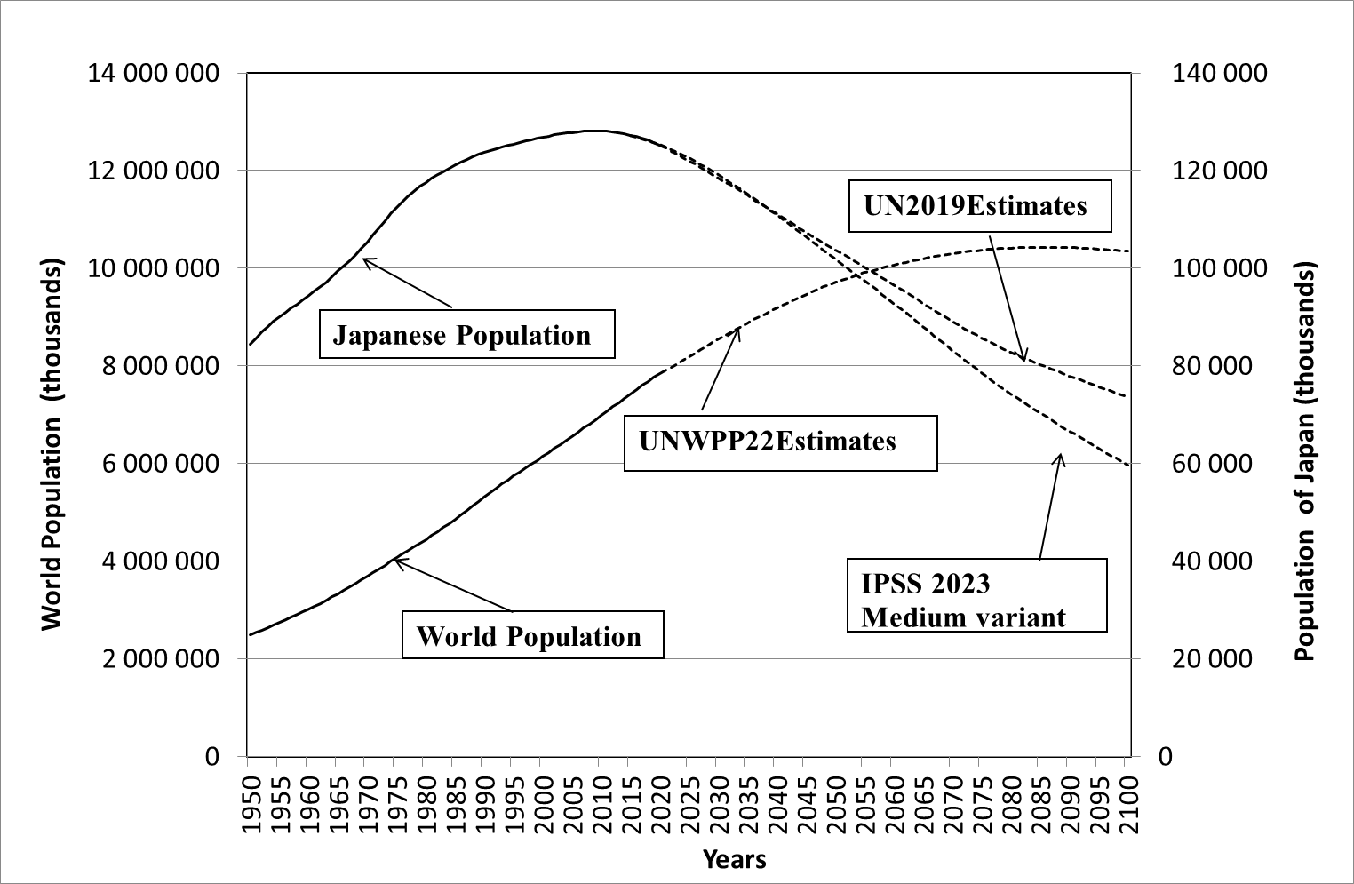
Figure1: Long term Population Development of the World (UNWPP2022) and Japan.
Source: United Nations, 2022; IPSS, 2023.

Slide 6
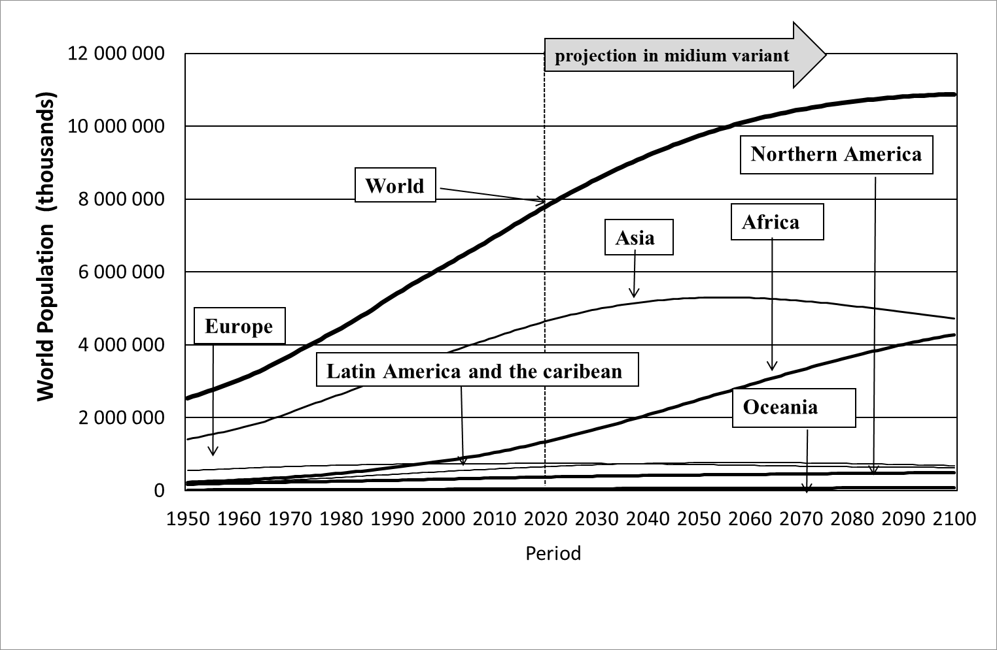
Figure 2: Increasing World’s Population and Population by Regions (UNWPP2022)
Sources : Estimates (1950-2021) projections (2022-2100) in medium variant (United Nations, 2019)

Slide 7
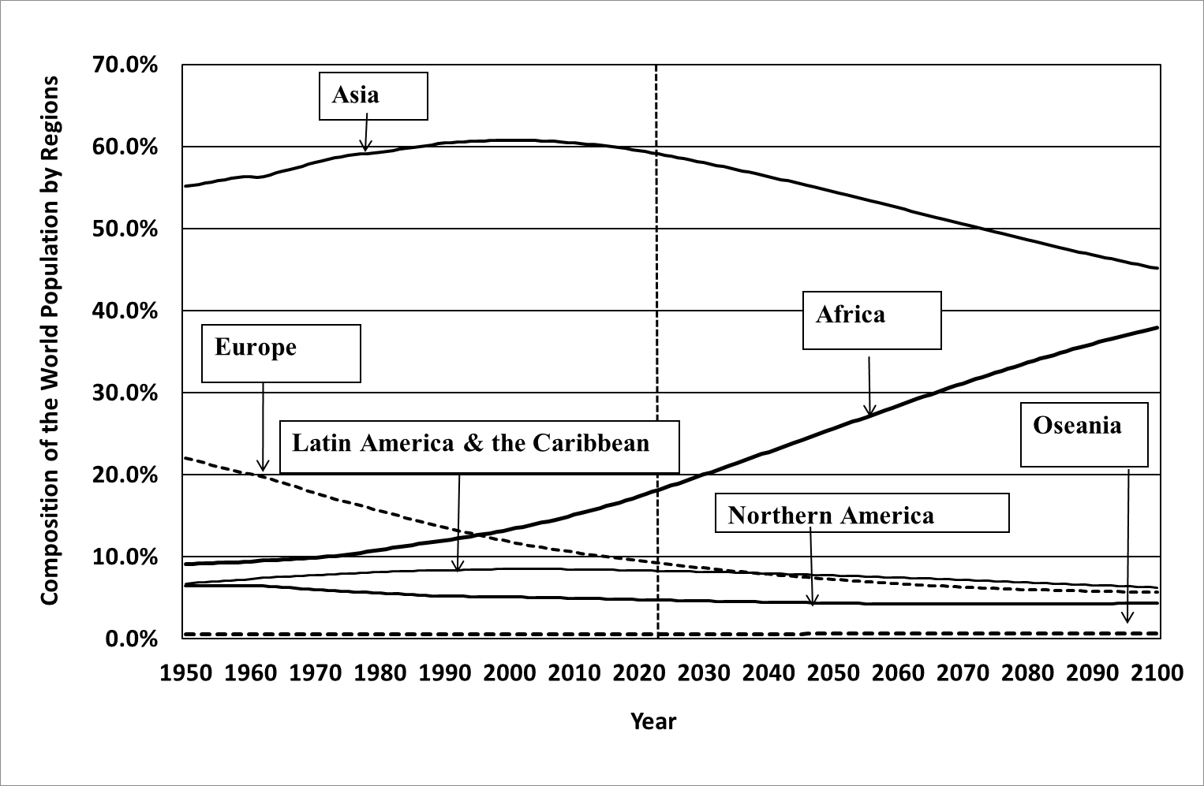
Figure 3: Changing Composition of the World Population by Regions (UNWPP2022)
Sources : Estimates (1950-2022) projections (2022-2100) in medium variant (United Nations, 2023)

Slide 8
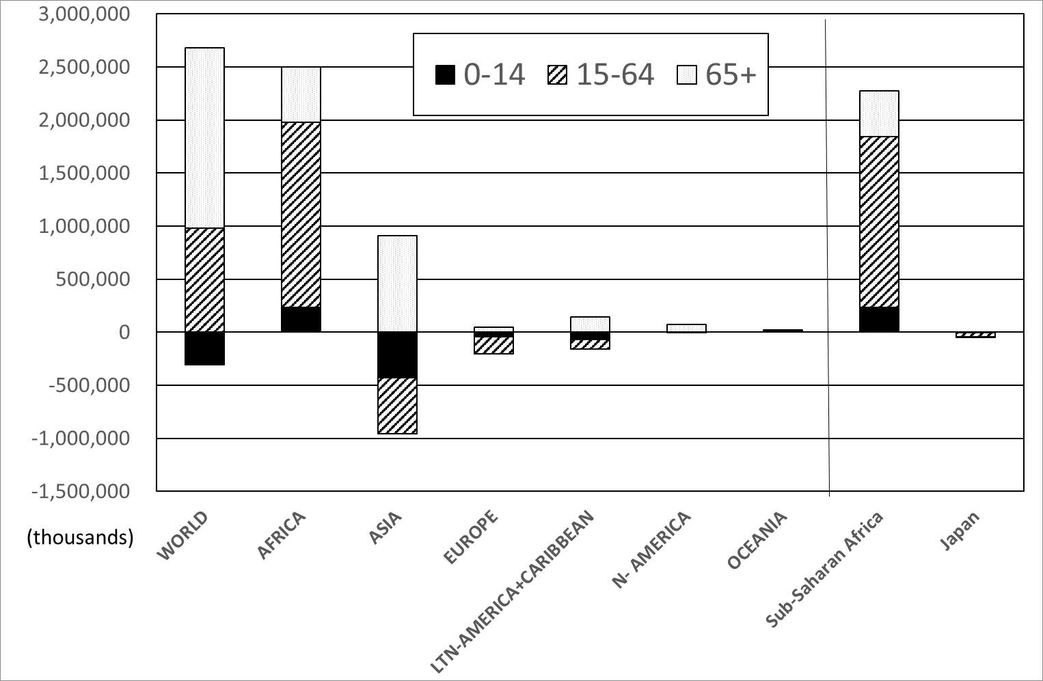
Figure 4: Population Changes in the Next 2.3 Billion by Age Group and Regions
Source: United Nations, 2022a.

Slide 9
2 Japan As a Precursor Case of Depopulation
Following Japan, the EU, China, and most of countries are expected to undergo a long period of population decline by 2050.
In fact, almost two thirds of the world’s population lives in countries in which the total fertility rate (TFR) is below the replacement level (United Nations 2022b). （Figure ）
Net Reproduction Rate (NRR) in 2022 is estimated below the replacement level in most of regions except Sub-Sahara Africa.（Figure 6）

Slide 10
**Japan As a Precursor Case of Depopulation
The lowest fertility is no longer a Japanese monopoly. In East Asia, Taiwan, Singapore, Korea and China, the fertility decline is unstoppable.
Even after cancellation of its one-child policy, China’s TFR will continue to drop, partly as an impact of Covid-19. China’s population began to decrease from 2022.

Slide 11
**Japan As a Precursor Case of Depopulation
The lowest fertility is no longer a Japanese monopoly. In East Asia, Taiwan, Singapore, Korea and China, the fertility decline is unstoppable.
Even after cancellation of its one-child policy, China’s TFR will continue to drop, partly as an impact of Covid-19. China’s population began to decrease from 2022.

Slide 12
**Japan As a Precursor Case of Depopulation
This suggests that the increase in life expectancy (increase in average life expectancy) (Fig.7) leads to small number of Children per family, later marriage.
And the later fertility will fall below replacement level and the population will begin to decline.
I see this process as a phenomenon common to all humans (Homo sapiens) worldwide.

Slide 13
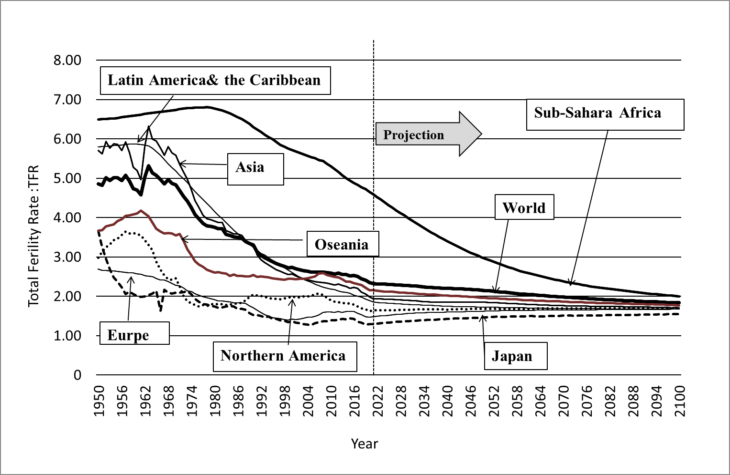
Figure 5: Changing Total Fertility Rates by Region (UNWPP2022)
Sources : Estimates (1950-2021) projections (2022-2100) in medium variant (United Nations, 2022a)

Slide 14
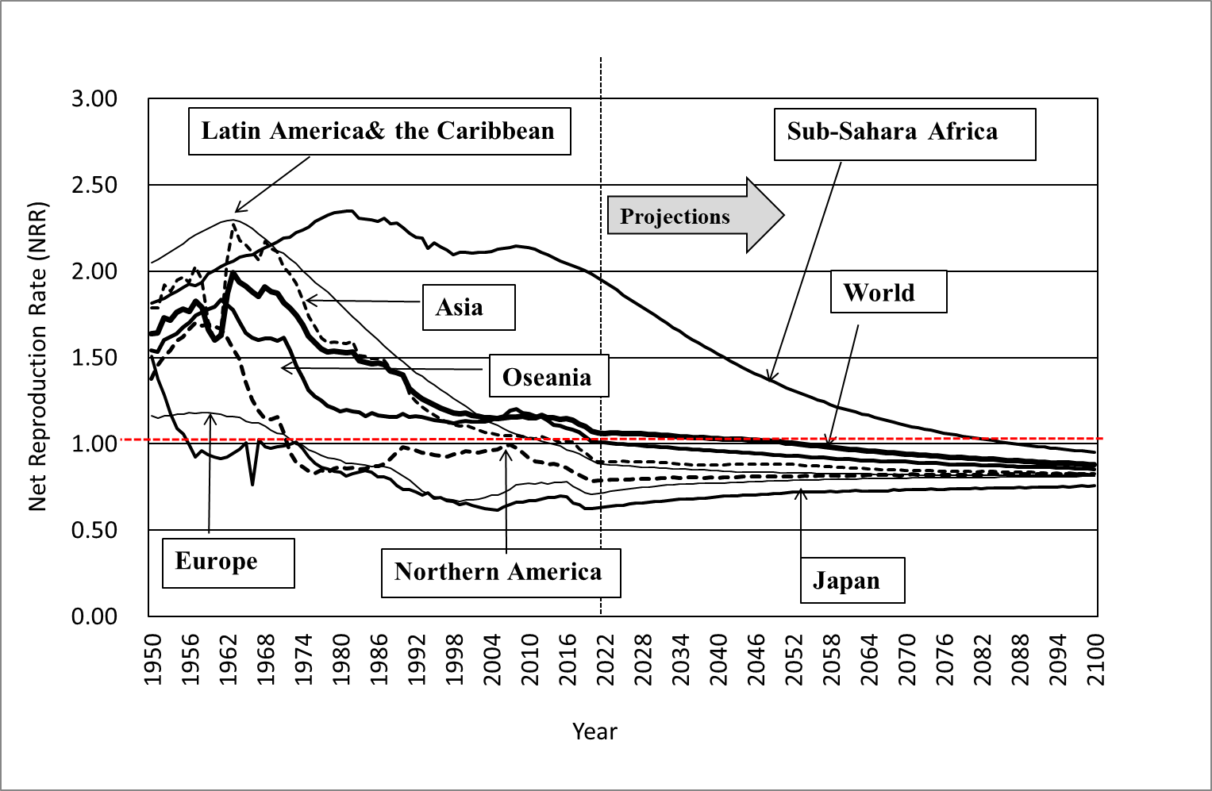
Figure 6: Changing Net Reproduction Rates(NRR) by Region (UNWPP2022)
Source: United Nations 2023a.

Slide 15
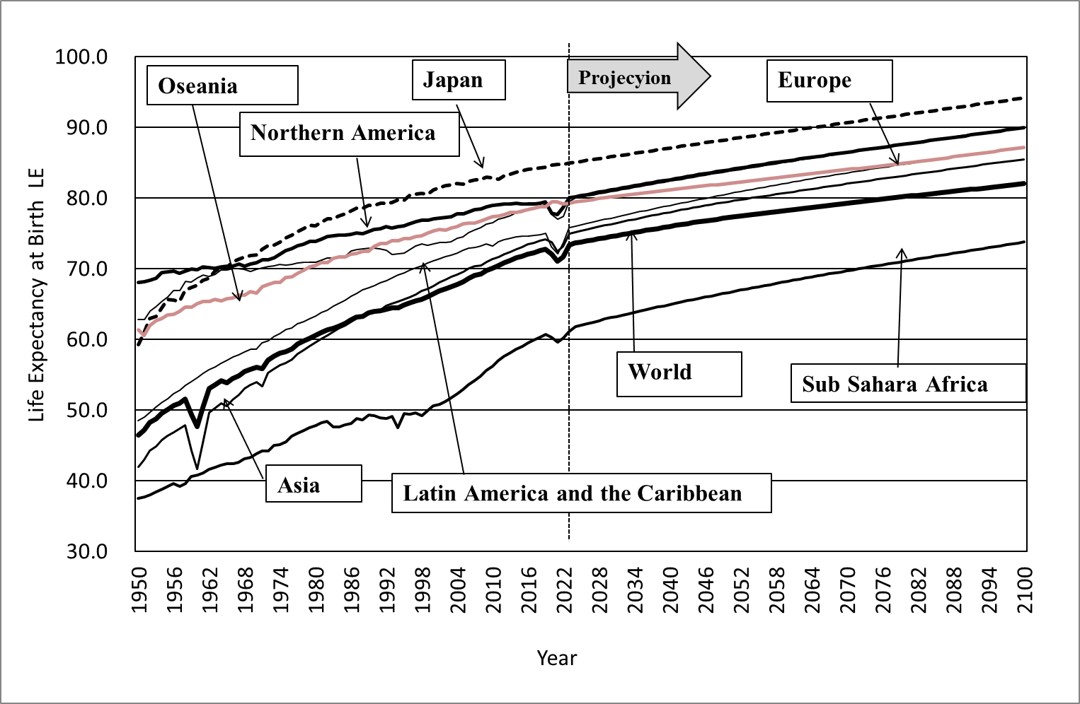
Figure 7: Changing Life Expectancy by Region (UNWPP2022)
Sources : Estimates (1950-2021) projections (2022-2100) in medium variant (United Nations, 2022)

Slide 16
3. Population Dynamics of Japan
From 1950 to 2018, the population dynamics of Japan, depending mainly on natural dynamics (live births and deaths), and social dynamics (immigration and emigration) have been limited in scale (except when Okinawa reverted to Japan in 1971). （Figure 8.9）
Since 2007, the natural dynamics turned negative and total population is shrinking continuously.
On the other hand, around 2012, the social dynamics (immigration) began to increase, which made the population decline slightly weaken. （Figure 8.9）

Slide 17
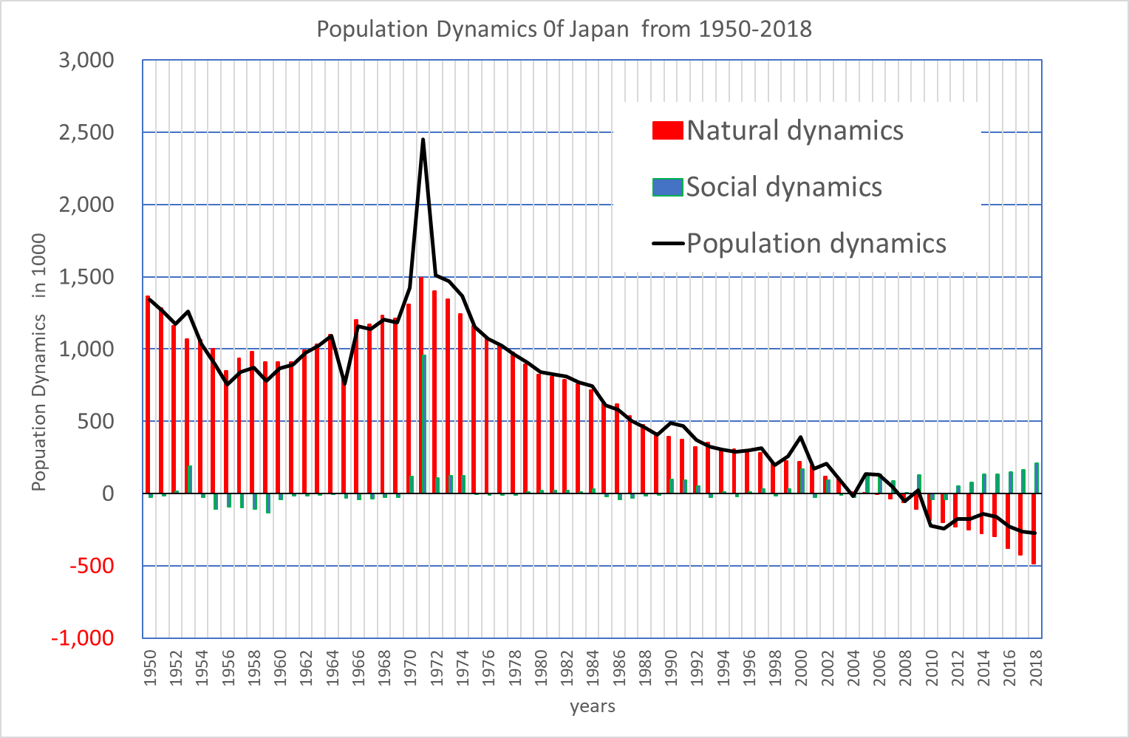
Figure 8 Population Dynamics 0f Japan 1950-2018
Source: IPSS, 2021

Slide 18
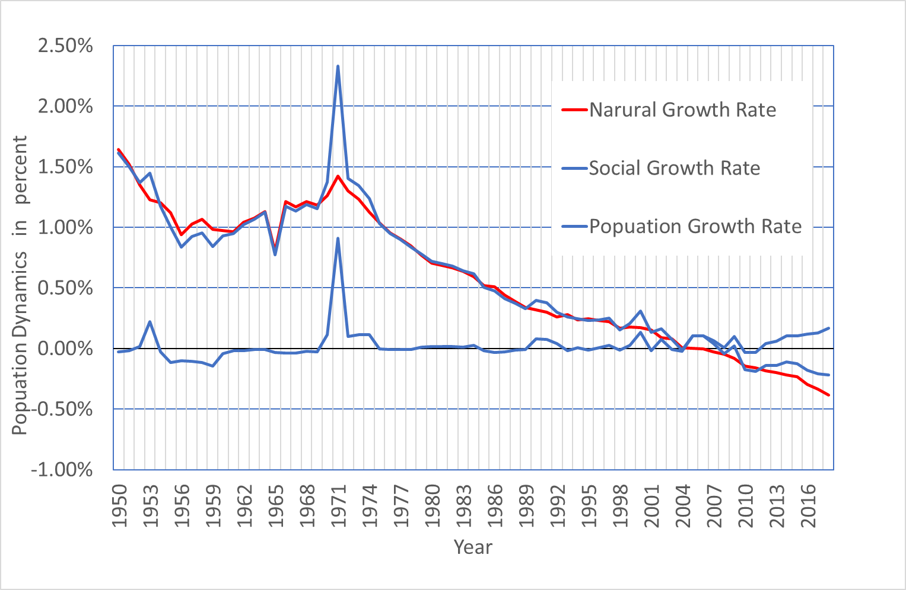
Figure 9 Population Dynamics 0f Japan 1950-2018
Source: IPSS, 2021

Slide 19
* Population Dynamics of Japan
Further, the natural dynamics (CBR: crude birth rate, CDR: crude death rate, NGR（natural growth rate) over the very long term, from 1873 to 2019, show
the First Demographic Transition (FDT) from high fertility and mortality to low fertility and mortality and
the Second Demographic Transition (SDT),where the natural dynamics turned negative (as a result of low fertility and aging) and depopulation began. (Fig.10)

Slide 20
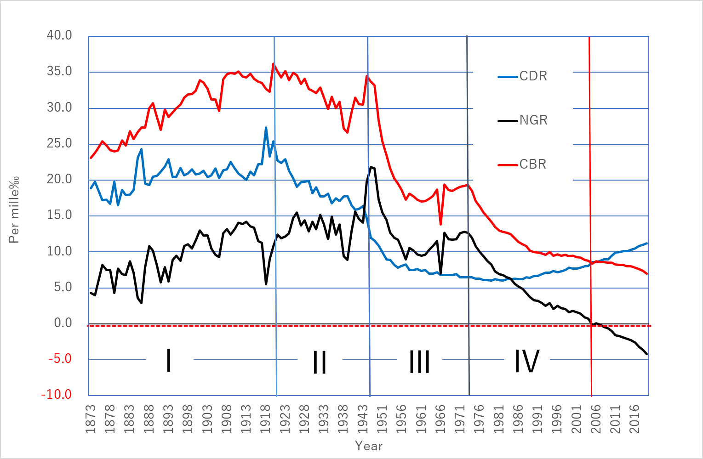
Figure 10 Long-term transition of Natural Dynamics in Japan
1873-2018
crude death rate
crude birth rate
natural growth rate
Source: IPSS, 2021
Notes:
アブリビエーションだと、慣れていない研修員がわからなくなりそうなので、ここまでは念押しでオリジナルを併記していただけると助かります

Slide 21
4. Causalities of Demographic Transition
(1) FDT in Japan
The First Demographic Transition in Japan started with modernization from the Meiji Era and continued to the mid-1970s.
The growing social capital and social product extended the average life span of women from 50 to over 70 years, thus the survival rate of women at the end of their reproductive period rose from 50 % to nearly 100 %.
As a result, fertility was reduced from 4 to 2 children as the higher risk of having many children promoted birth control, i.e. it reached mere replacement level fertility .（Figure 10）

Slide 22
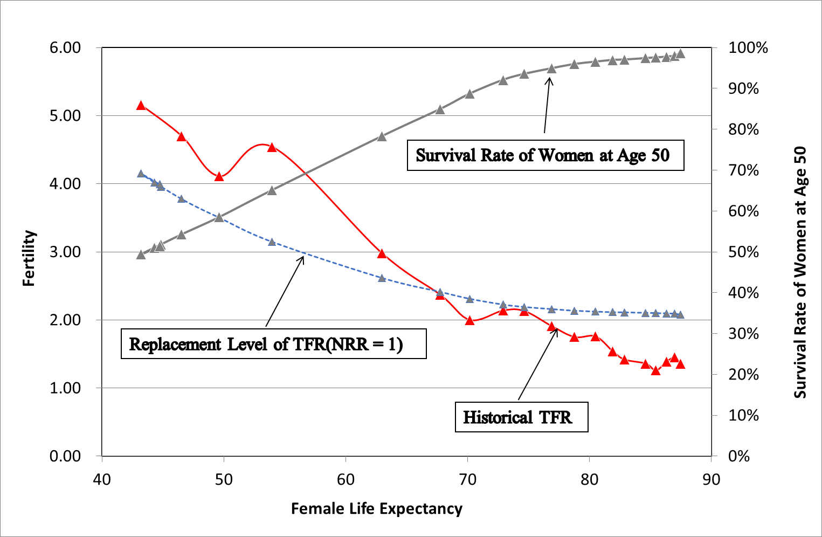
Figure 11 :
Women’s life expectancy and fertility change
Source：Hara（2020)

Slide 23
*Causalities of Demographic Transition
(2) SDT in Japan
The Second Demographic Transition in Japan was caused by the shift of reproduction to a higher age.
With the liberalization of marriage behaviors*, late marriage and late childbearing was promoted.
Above all, the social norm on marriageable age (Kekkon Tekireiki in Japan, which pressured women to marry before 24 years old), evaporated.
The reproductive period of women was cut back and, as a result, marriage became rarer, and more couples became childless or with only one child. The multiple child household is vanishing.（Figure 10）.

Slide 24
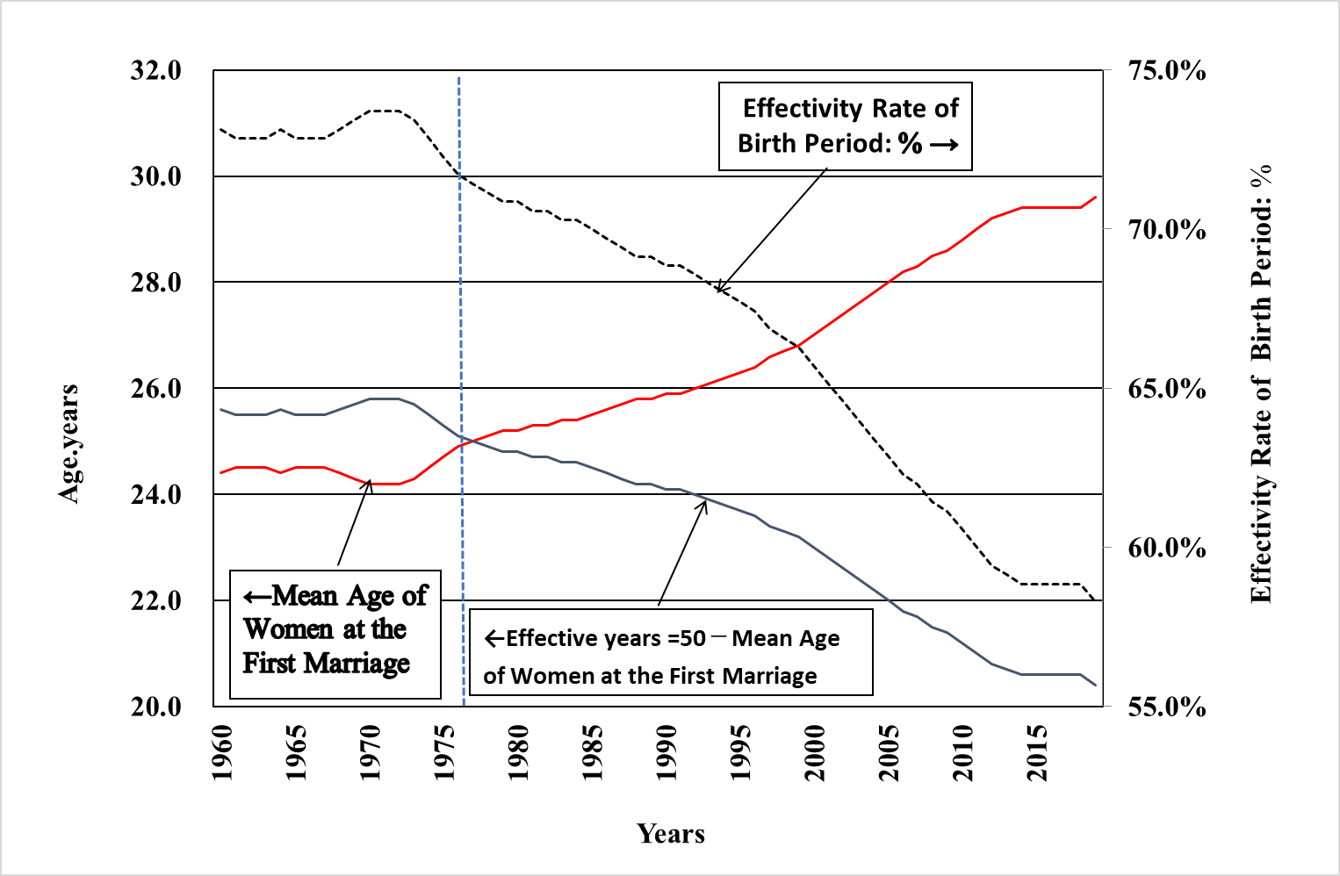
Figure 10:
Effects of late marriage and late childbearing
Source：Hara（2020）

Slide 25
Conclusion :Depopulation is unprecedented national crisis ?
The Japanese Prime Minister Kishida Kunio regards the present demographic situation of Japan, so called “Shoshi Kourei Jinkou Genshyou (Fewer Children, Rapid Aging and Depopulation）” as unprecedented national crisis.
However, what this demographic shift in Japan means is a human historical situation in which human society, which has pursued affluence and freedom, has increased its longevity through the rapid development of productive forces, while at the same time expanding its freedom to control its own fertility, resulting in a demographic imbalance in society as a whole due to the free choices of individuals.

Slide 26
Conclusion :Depopulation is unprecedented national crisis ?
Therefore, what we can do at present is to support and accelerate the population transition in the less developed regions by taking advantage of the time lag between the less developed regions and the more developed regions, while at the same time slowing down the pace of aging and population decline in the more developed regions as much as possible, and addressing the various social, economic, cultural and political issues that arise as a result of aging and population decline, and improving social systems to ensure their sustainability.
Finally. I will indicate some of the problems ermaering with a shrinking population as follows;

Slide 27
Income redistribution to ensure effective demand
Needs for increasing productivity ⇒ mechanization
Restructuring labor demand and supply
Distribution issues among the different population groups
Population Reallocation in concern with the infrastructure and environment from global aspect
Taking Initiative in International population movement
Thank you for your attention !
t
Notes:
According to UN Projection 2017, the world's population in 2015 was 7.38 billion and it will increase continuously and will top 11 billion by 2100.
On the other hand, the same UN projection states that Japan’s population will decrease from 130 million in 2015 to 80 million by 2100. According to Japanese demographic institutes, Japan’s population will be even less than 60 million by 2100 (Fig. 1).

Slide 28
References
Hara T (2014) A Shrinking Society: Post-Demographic Transition , in Series: SpringerBriefs in Population Studies Subseries: Population Studies of Japan, (https://www.springer.com/gp/book/9789811336539).Springer
Hara,T(2020) An Essay on the Principle of Sustainable Population, in Series: SpringerBriefs in Population Studies Subseries: Population Studies of Japan, (https://www.springer.com/gp/book/9789811336539).Springer
IPSS (2023a) Population Projections for Japan: 2021 to 2070 (With long-range Population Projections: 2071 to 2120) https://www.ipss.go.jp/pp-zenkoku/e/zenkoku_e2023/pp_zenkoku2023e.asp
IPSS (2023b) Population statistics of Japan 2023. https://www.ipss.go.jp/p-info/e/psj2023/PSJ2023.asp
United Nations(2022a) World Population Prospects 2022 [Database]. https://population.un.org/wpp/
United Nations.(2022b) World Population Prospects 2022: Summary of Results. UN DESA/POP/2022/TR/NO.3.
Sustainable Development Report (formerly the SDG Index & Dashboards). 2019. GlobalIndexResults2019. https://www.sdgindex.org/reports/sustainable-development-report-2019/ Accessed 03 .09.202 .
Van de Kaa DJ (2002) The idea of a second demographic transition in industrialized countries. In:Paper to be presented at the sixth welfare policy seminar of the national institute of population and social security (NIPSSR), 29 January 2002. Tokyo, Japan. https://pdfs.semanticscholar.org/17c8/c2c3b43d447474107554926eb289d269c939.pdf.

Slide 29
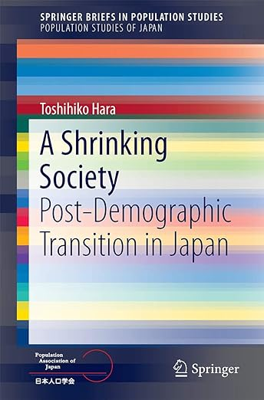
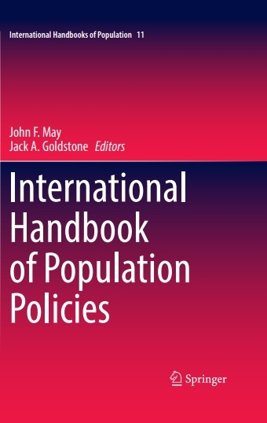

Toshihiko HARA
Sapporo City University, Professor Emeritus (Ph.D. in Sociology)
Kita34 Higashi19 Chyome 3-7, Higashi-Ku, Sapporo, 007-0834 JAPAN
TEL/+81-090-2077-6027
E-mail：t.hara@scu.ac.jp，http://toshi-hara.jp

