Slide 1
Population Development and Sustainable Use of Forest/Natural Resources
Toshihiko HARA (Sapporo City University, professor emeritus, Sapporo Japan) Email: t.hara@scu.ac.jp
2023 JICA :Knowledge Co Creation Program (Group & Region Focus)
Sustainable Use of Forest/Natural Resources and Local
Strengthening of Value Chain/Course No.: 202 208433 J001
Program Period : From October 23 , 202 3 to December 8 , 202 3

Slide 2
Introduction
In this lecture, in part one, I talk about the world population development from the present to the future. In concern with SDGs, among all, the rapid population increase in developing countries are regarded as main causes of poverty and natural environment destruction. This situation still exist. But in other regions of the worlds except for Sub Saharan Africa, the population will end up increasing and turn to decrease in next 30 years.
Therefore, in part two, I talk about the relations between SDGs and population development, and the population increase vs. population decrease as different natures.
Finally, we think about the sustainable use of forest/natural resources, especially with decreasing and shrinking population in our future.

Slide 3
1． Sustainability of World Population ?
Using the United Nations World Population Prospects, I will show that most countries, except for sub-Saharan Africa, have already completed their demographic transition and are now entering the post-demographic transition period.
Following Japan, the developed countries will begin to experience population decline by 2050. And by the end of this century, the world's population growth will be over, after which the entire world will enter a period of population decline.

Slide 4
1-1 World Population Prospects 2022
(UNWPP2022)
The United Nations projected that the world’s population is expected to grow from 8 billion in 2022 、to peak off with 10.4 billion in 2086, then to turn in decrease to 10.3 billion in 2100. We will still have a 30% increase from 2022. (United Nations 2022). （Figure1）
However, if we take a closer look at this growth, most of the increase (about 95.8%) is expected in Sub-Saharan Africa. In most other regions except for Africa, population growth will continue but only the elderly (65+) will increase, while working-age adults (15–64) and children (0–14) will decrease. （Figure2）

Slide 5
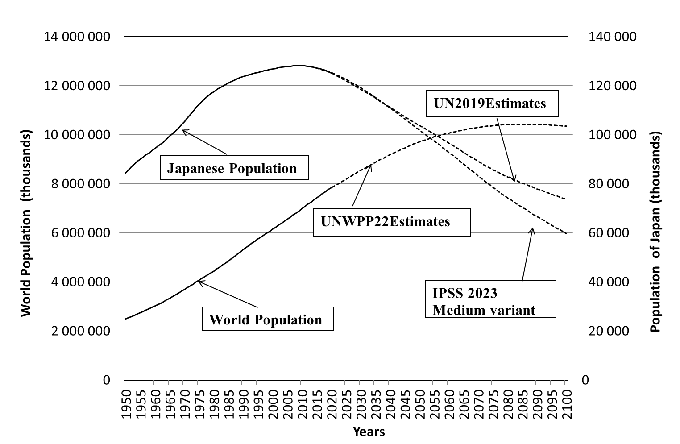
Figure1: Long term Population Development of the World (UNWPP2022) and Japan.
Source: United Nations, 2022; IPSS, 2023.

Slide 6
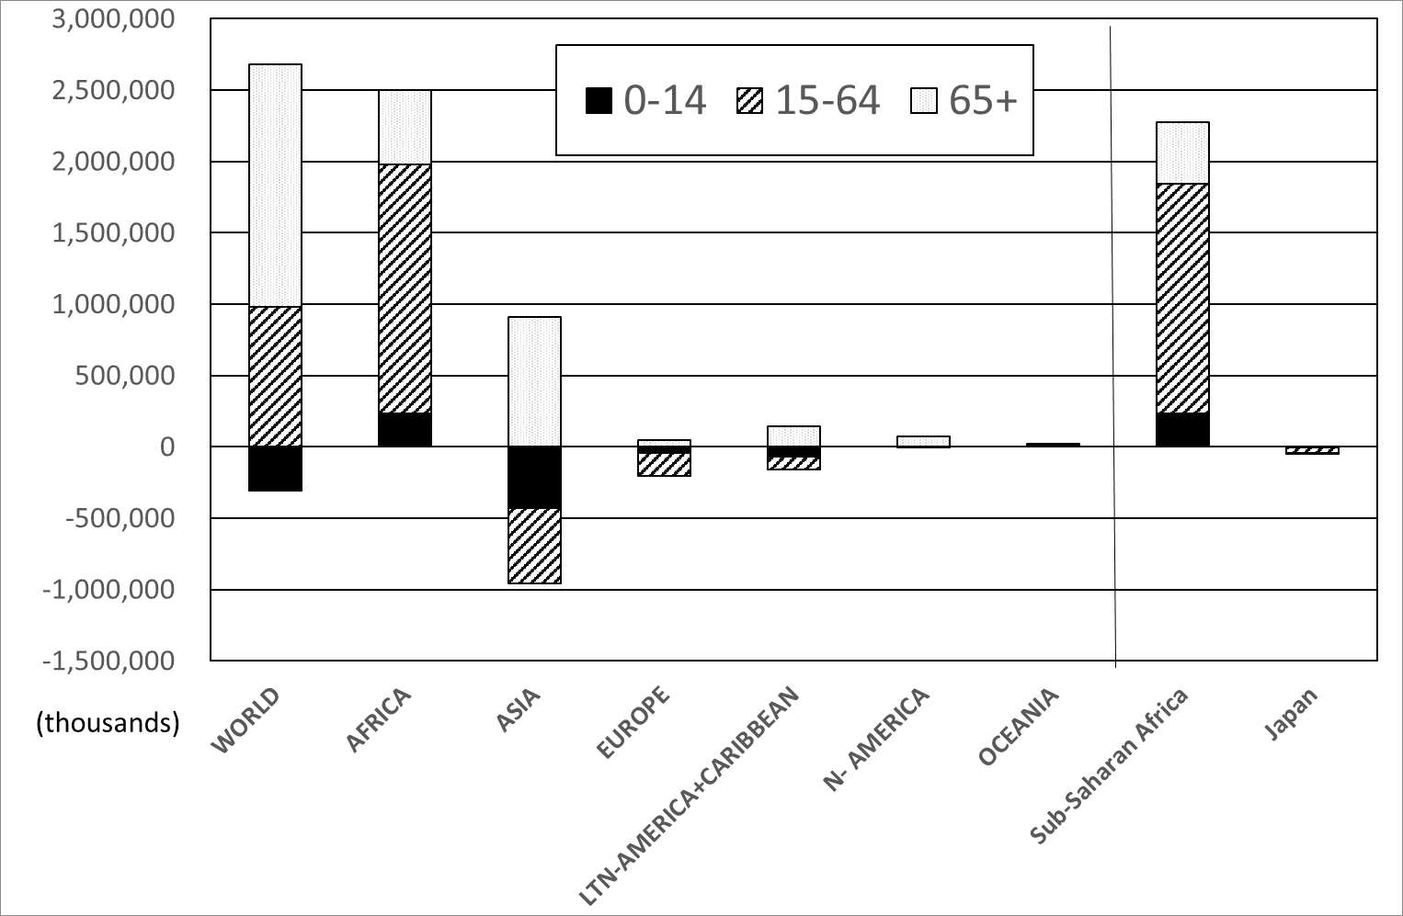
Figure 2: Population Changes in the Next 2.3 Billion by Age Group and Regions
Source: United Nations, 2022a.

Slide 7
1-2 Japan As a Precursor Case of Depopulation
Therefore, following Japan, the EU, China, and most of countries are expected to undergo a long period of population decline by 2050. （Figure2）
In fact, almost two thirds of the world’s population lives in countries in which the total fertility rate (TFR) is below the replacement level (United Nations 2022b).
Net Reproduction Rate (NRR) in 2022 is estimated below the replacement level in most of regions except Sub-Sahara Africa.（Figure ３）

Slide 8
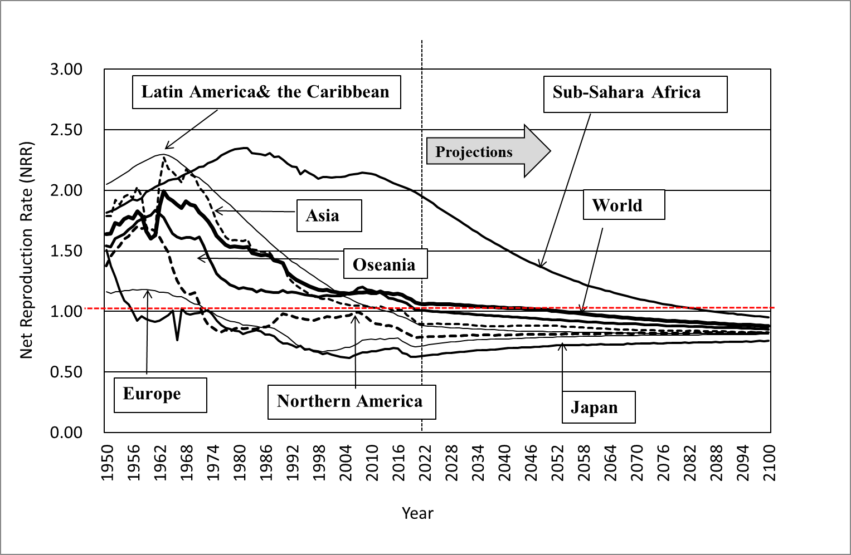
Figure 3: Changing Net Reproduction Rates(NRR) by Region (UNWPP2022)
Source: United Nations 2023a.

Slide 9
**Japan As a Precursor Case of Depopulation
The lowest fertility is no longer a Japanese monopoly. In East Asia, Taiwan, Singapore, Korea and China, the fertility decline is unstoppable.
Even after cancellation of its one-child policy, China’s TFR will continue to drop, partly as an impact of Covid-19. China’s population began to decrease from 2022.

Slide 10
1-3 Population Dynamics of Japan
From 1950 to 2018, the population dynamics of Japan, depending mainly on natural dynamics (live births and deaths), and social dynamics (immigration and emigration) have been limited in scale (except when Okinawa reverted to Japan in 1971). （Figure 4，5）
Since 2007, the natural dynamics turned negative and total population is shrinking continuously.
On the other hand, around 2012, the social dynamics (immigration) began to increase, which made the population decline slightly weaken. （Figure 4，5）

Slide 11
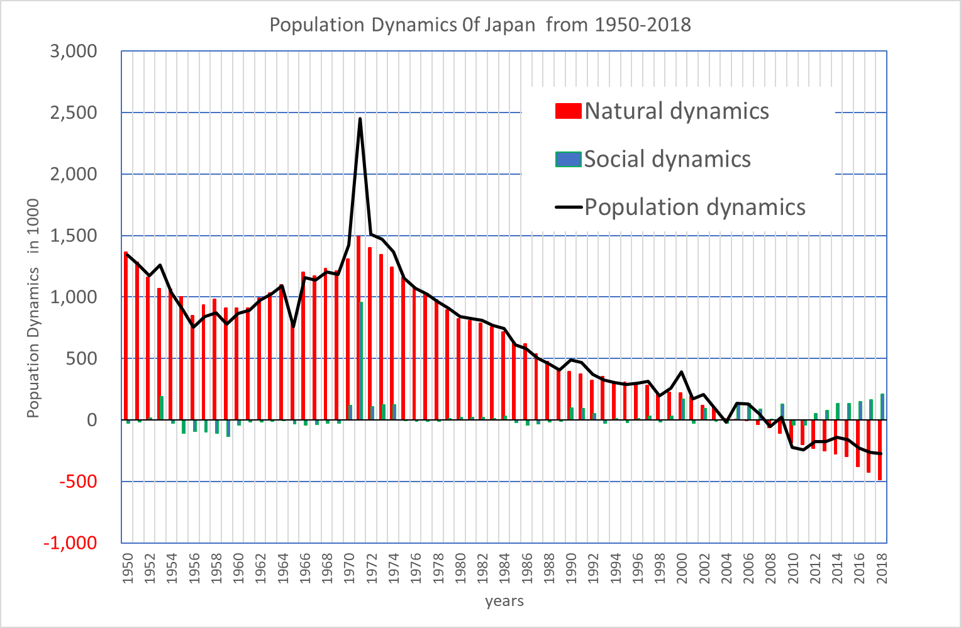
Figure 4 Population Dynamics 0f Japan 1950-2018
Source: IPSS, 2021

Slide 12
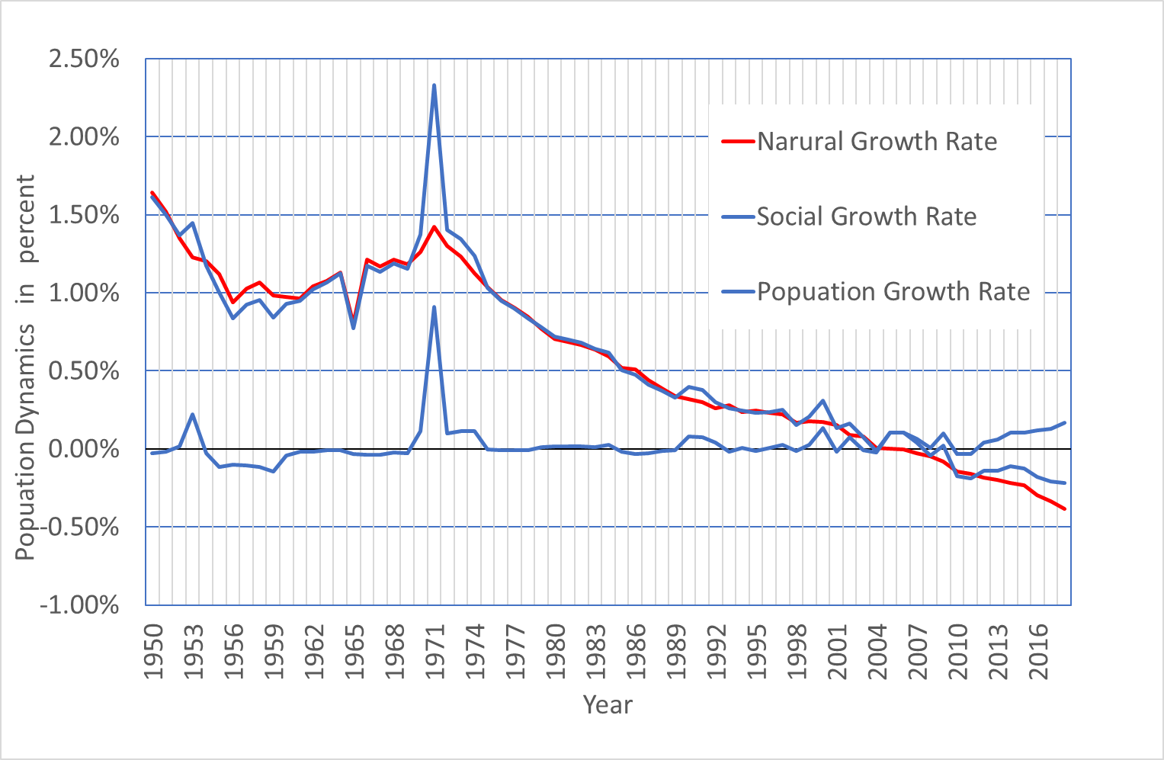
Figure 5 Population Dynamics 0f Japan 1950-2018
Source: IPSS, 2021

Slide 13
* Population Dynamics of Japan
Further, the natural dynamics (CBR: crude birth rate, CDR: crude death rate, NGR（natural growth rate) over the very long term, from 1873 to 2019, show
the First Demographic Transition (FDT) from high fertility and mortality to low fertility and mortality and
the Second Demographic Transition (SDT),where the natural dynamics turned negative (as a result of low fertility and aging) and depopulation began. (Fig.６)

Slide 14
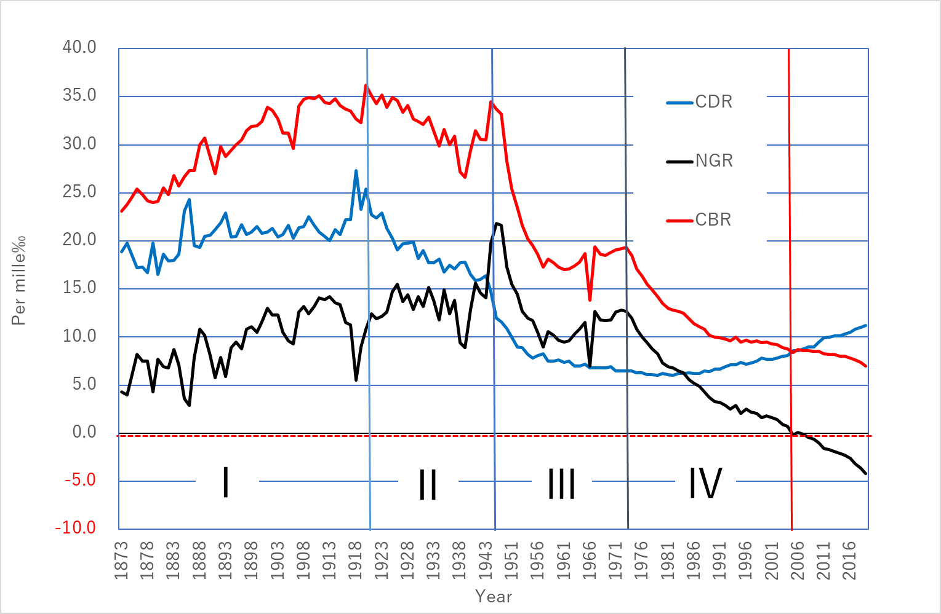
Figure 6 Long-term transition of Natural Dynamics in Japan
1873-2018
natural growth rate
crude birth rate
crude death rate
Source: IPSS, 2021
Notes:
アブリビエーションだと、慣れていない研修員がわからなくなりそうなので、ここまでは念押しでオリジナルを併記していただけると助かります

Slide 15
1-４. Demographic Transition Theory
The First Demographic Transition： FDT, or Classical DT （Figure7）
The historical process from high mortality and fertility in pre-industrial society, to low mortality and fertility in post-industrial society.
It was proposed by Warren Thompson in 1929 and named by Frank W. Notestein in 1945（Wikipedia 2021).
This process is composed by 4 stages：I (Pre-transition) ,II(Early transition）,III( Late transition ) ,IV:( Post-transition )

Slide 16
Figure 7
The First Demographic Transition
CBR
CDR
I (Pre-transition) CBR, CDR ≒ 40‰ r≒０
II(Early transition) CBR still high, CDR begins to decrease. r>0
III( Late transition ) CBR begins to decrease , CDR is low. r>0
IV:( Post-transition ) ) CBR, CDR ≒ 10‰ r≒0
Source：Hara（2020）

Slide 17
*Demographic Transition Theory
The Second Demographic Transition： SDT was indicated by Lesthaeghe and Van de Kaa in 1986
（Figure ８）
Highly industrialized countries are entering a further demographic transitional stage. A stage characterized by full control over fertility. Couples appear to lack the motivation to have more than one or two children, Fertility declined below replacement level, an element of postponement of births involved in the very low levels of fertility currently observed, Signs are that fertility will continue to stay at a level below that required for the replacement of generations. A new demographic imbalance and a compensatory trend of migration (Van de Kaa 2002:1-2).
As a consequence of hyper aging, it began to undergo a long period of population decline.

Slide 18
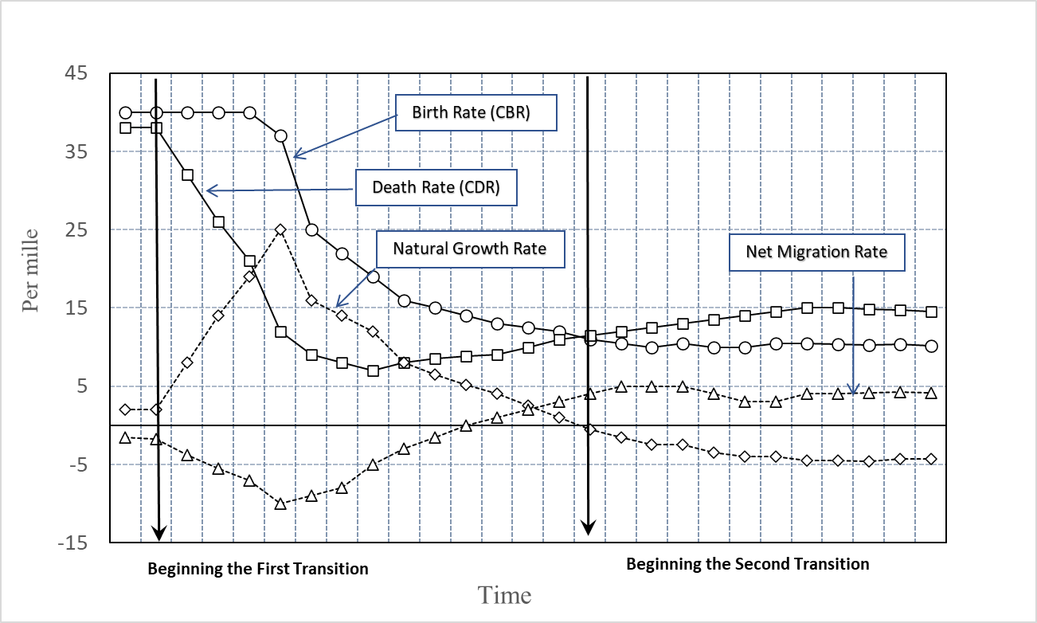
Figure 8: Model of First and Second Demographic Transitions
Source: van de Kaa 2002. Drawing by the author.

Slide 19
1-５. Causalities of Demographic Transition
(1) FDT in Japan
The First Demographic Transition in Japan started with modernization from the Meiji Era and continued to the mid-1970s.
The growing social capital and social product extended the average life span of women from 50 to over 70 years, thus the survival rate of women at the end of their reproductive period rose from 50 % to nearly 100 %.
As a result, fertility was reduced from 4 to 2 children as the higher risk of having many children promoted birth control, i.e. it reached mere replacement level fertility .（Figure 9）

Slide 20
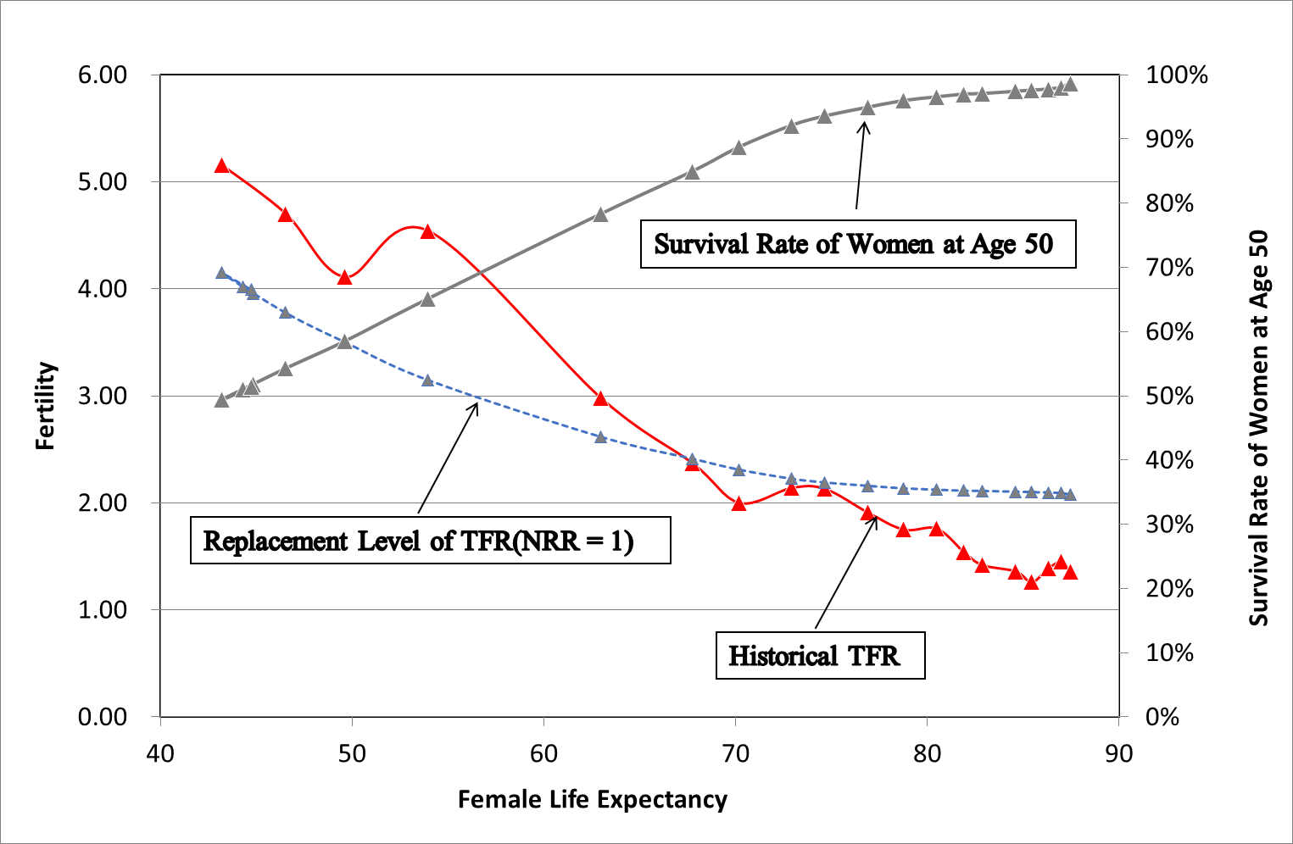
Figure 9 :
Women’s life expectancy and fertility change
Source：Hara（2020)

Slide 21
*Causalities of Demographic Transition
(2) SDT in Japan
The Second Demographic Transition in Japan was caused by the shift of reproduction to a higher age.
With the liberalization of marriage behaviors*, late marriage and late childbearing was promoted.
Above all, the social norm on marriageable age (Kekkon Tekireiki in Japan, which pressured women to marry before 24 years old), evaporated.
The reproductive period of women was cut back and, as a result, marriage became rarer, and more couples became childless or with only one child. The multiple child household is vanishing.（Figure 10）.

Slide 22
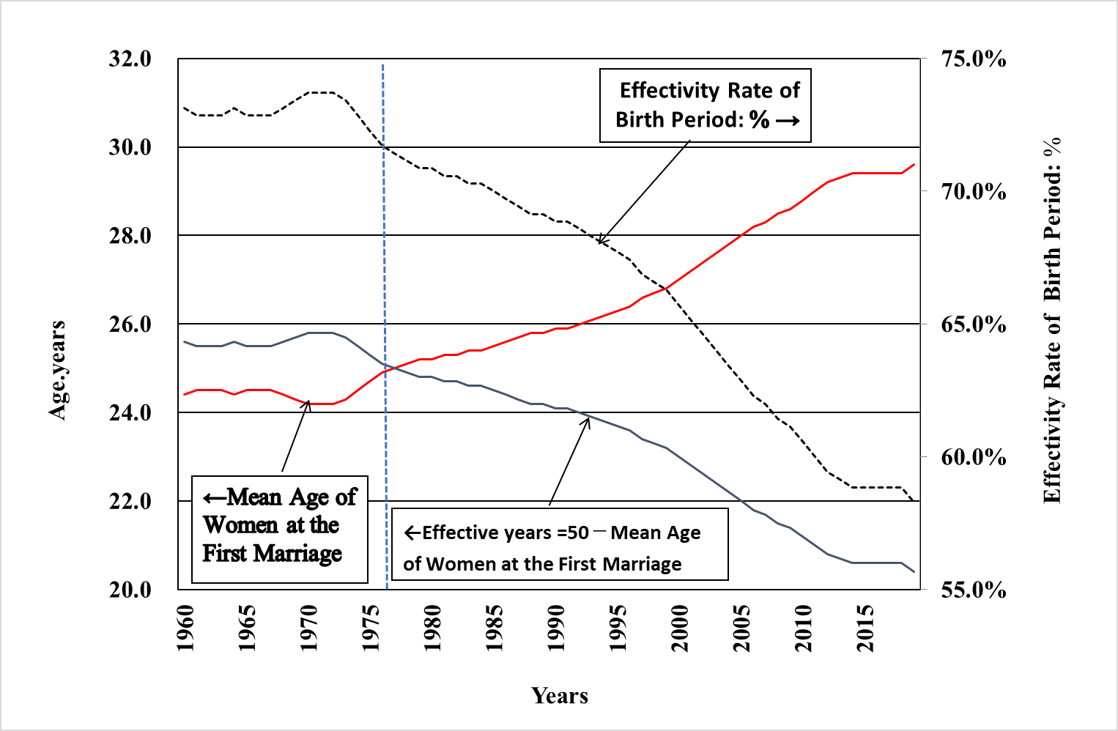
Figure 10:
Effects of late marriage and late childbearing
Source：Hara（2020）

Slide 23
* Fertility at Replacement Level
Total Fertility Rate (TFR) at replacement level: corrected for sex ratio at birth (usually 105 with more boys) and the probability of death of a woman (survival rate during the reproduction period 15-49) = TFR required to reproduce the population (number of children a woman will have in her lifetime).⇒ In Japan: 2.07 children per woman
Net Reproductive Rate (NRR): The number of girls needed to reproduce the population, based on the above concept. If the total fertility rate (TFR) is at the replacement level, NRR=1.

Slide 24
* Fertility at Replacement Level (for Example)
Japan's TFR 2019 = 1.36 children.
TFR at replacement level =2.07. That means the present TFR is (1.36 ÷ 2.07 )= 65.7% of TFR at replacement level
NRR （Net Reproduction Rate) = 0.657
Population decreasing rate per generation (30 years) = 1 - 0.65７ = -34.３%.

Slide 25
1-7 World Population in Future
Most of the population growth (about 95.8%) by 2100 is expected to occur in sub-Saharan Africa.
This projection assumes a gradual decline in the region's fertility rate (TFR) from 4.52 as of 2022, to 2.00 , while life expectancy increases from 60.2 to 73.8 years. (* Fertility rates in developed regions will slowly recover toward replacement levels.)
Sub-Saharan Africa will achieve self-sustaining economic growth, and 36.6% of the world's working-age population will live there.
★See Figure 11, 12, 13, 14

Slide 26
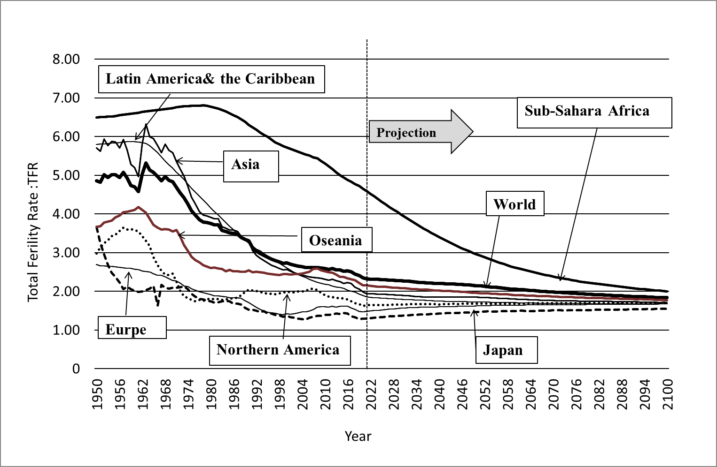
Figure 11: Changing Total Fertility Rates by Region (UNWPP2022)
Sources : Estimates (1950-2021) projections (2022-2100) in medium variant (United Nations, 2022a)

Slide 27
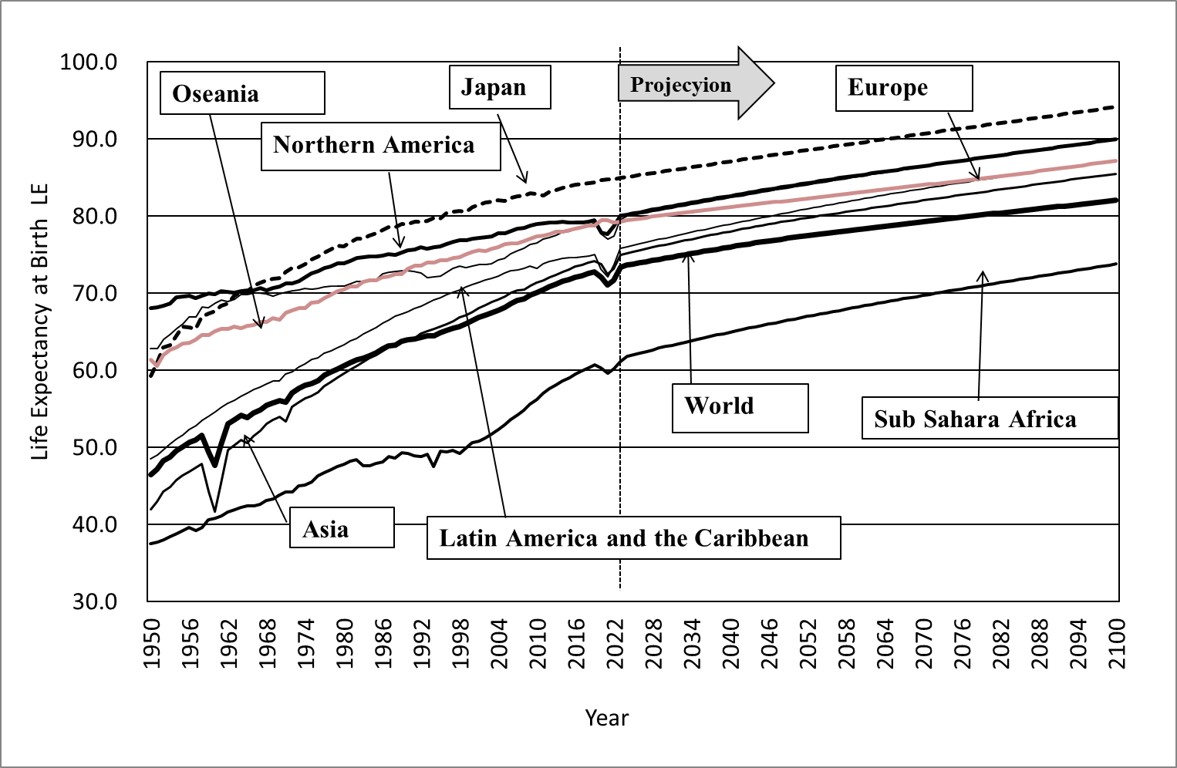
Figure 12: Changing Life Expectancy by Region (UNWPP2022)
Sources : Estimates (1950-2021) projections (2022-2100) in medium variant (United Nations, 2022)

Slide 28
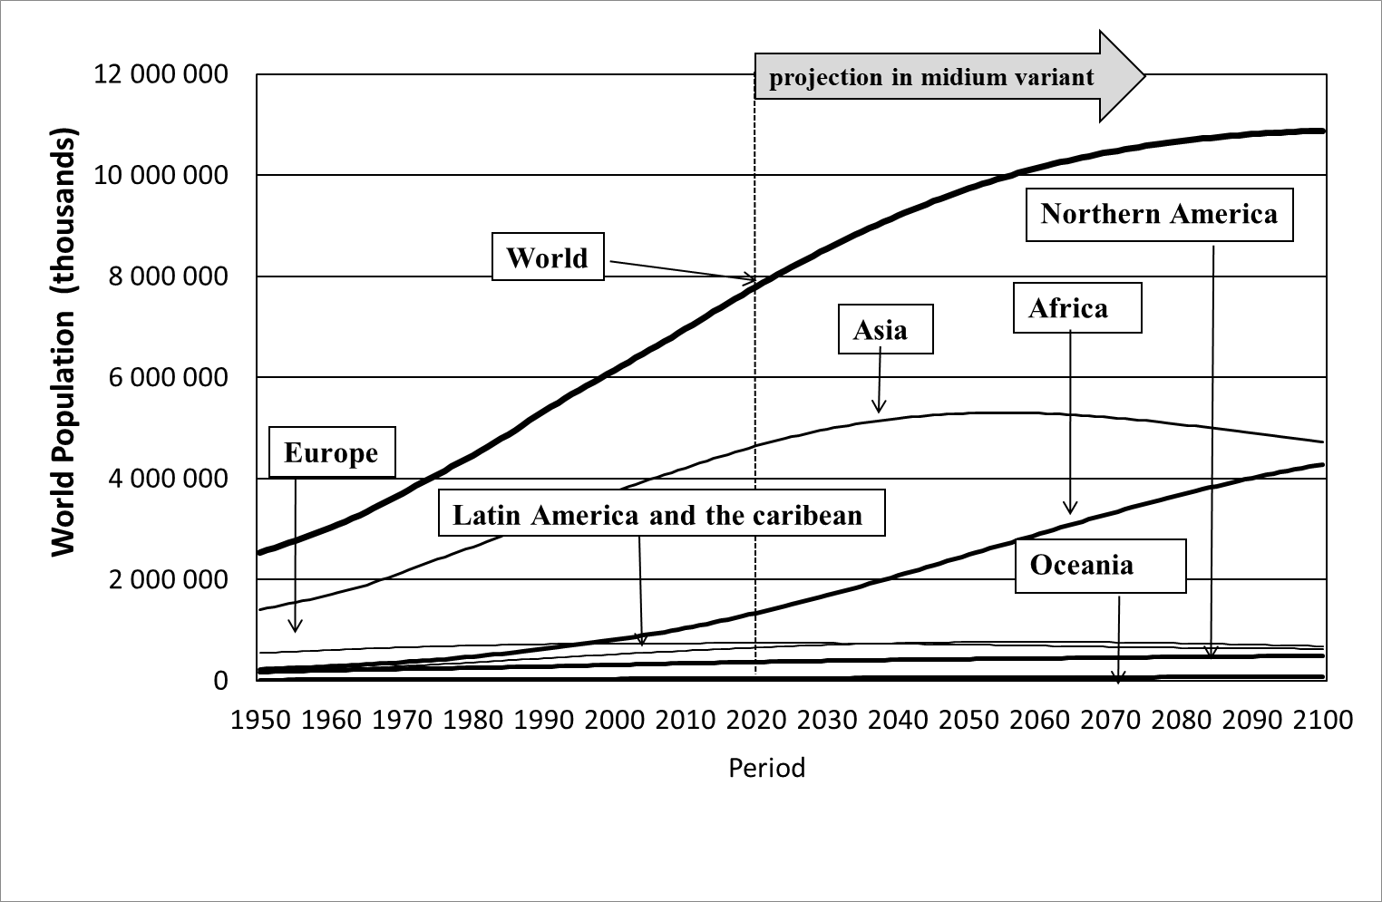
Figure 13: Increasing World’s Population and Population by Regions (UNWPP2022)
Sources : Estimates (1950-2021) projections (2022-2100) in medium variant (United Nations, 2019)

Slide 29
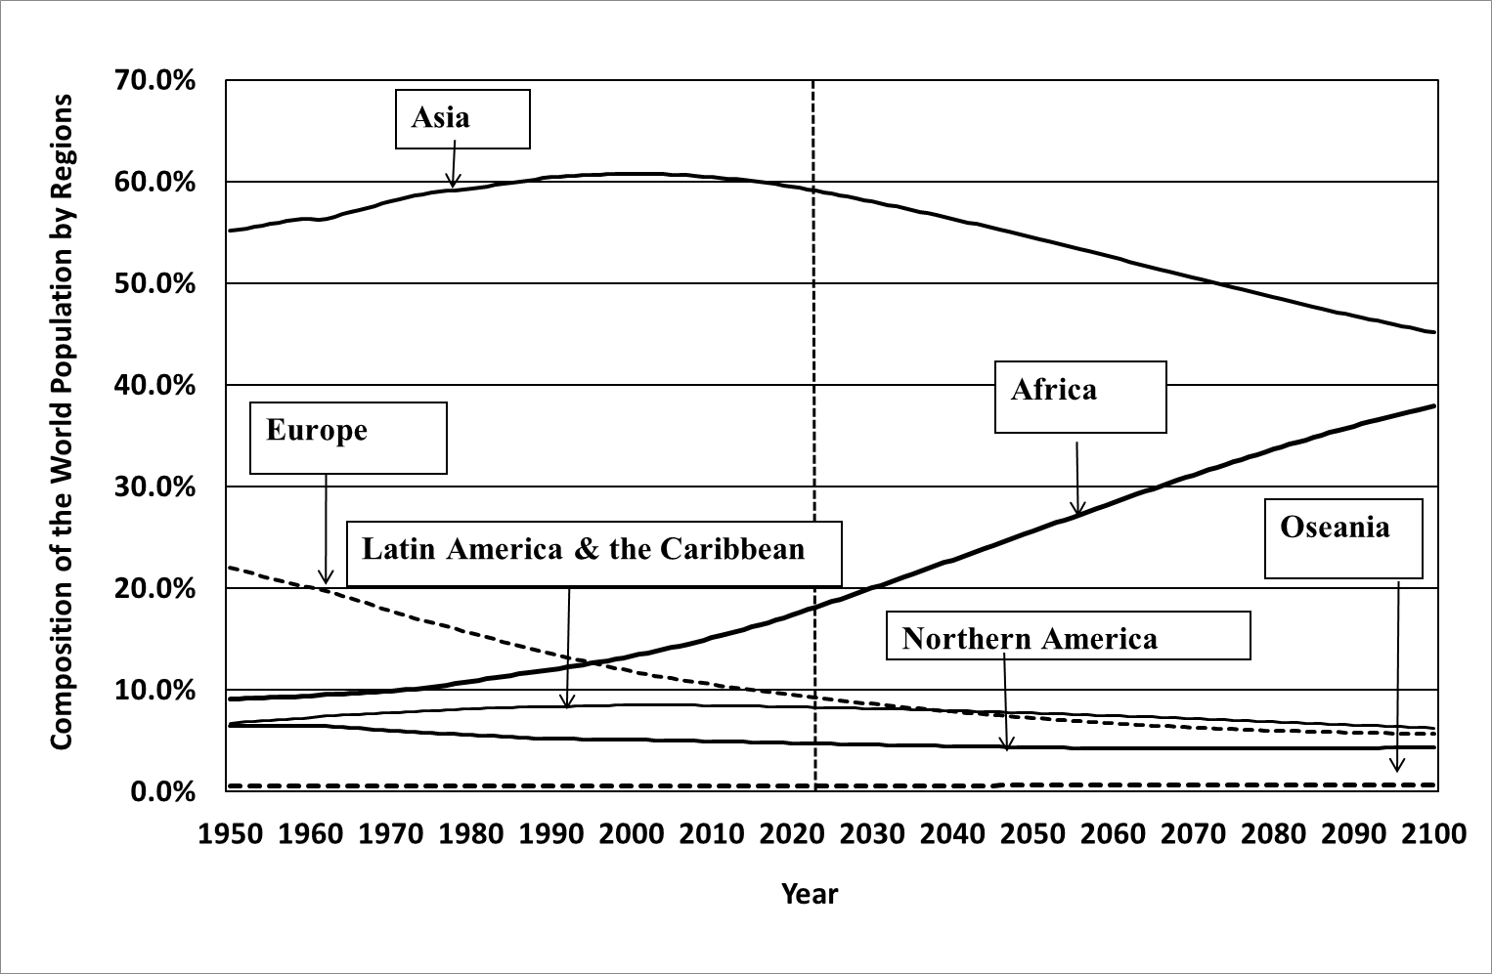
Figure 14: Changing Composition of the World Population by Regions (UNWPP2022)
Sources : Estimates (1950-2022) projections (2022-2100) in medium variant (United Nations, 2023)

Slide 30
2．Population and Sustainable Use of Forest/Natural Resource
In this section, we will address the question of how to use forests and the natural environment sustainably in the face of population change (especially the coming population decline).
Basically, it is important to avoid destroying the sustainability of the ecological environment of forests and natural resources, including the human population.
In other words, it is necessary to keep the balance of the ecosystem while maintaining and stimulating social and economic demands, avoiding unilateral withdrawal and devastation to the natural environment.

Slide 31
2-1 SDGs and World Population
The SDGs（Sustainable Development Goals）were adopted by all United Nations member states in 2015. They call to action to end poverty, protect the planet, and ensure that all people enjoy peace and prosperity by 2030（UNDP, 2019).
The SDGs are aiming for: 1) No Poverty, 2) Zero Hunger, 3) Good Health and Well-being, 4) Quality Education, 5) Gender Equality, 6) Clean Water and Sanitation, 7) Affordable and Clean Energy, 8) Decent Work and Economic Growth, 9) Industry, Innovation, and Infrastructure, 10) Reducing Inequality, 11) Sustainable Cities and Communities, 12) Responsible Consumption and Production, 13) Climate Action, 14) Life Below Water, 15) Life On Land, 16) Peace, Justice, and Strong Institutions, and 17) Partnerships for the Goals.

Slide 32
2-2 Global Index Score and Demographic Development
According to the Sustainable Development Report (Sachs et al., 2019), the Global Index Score shows different degree of goal attainment as of 2019 from the highest value of 85.2 in Demark to the lowest value of 39.1 in the Central African Republic.
The top 20 countries belong to OECD member countries (mostly in the EU) and most of the bottoms 20 countries are in Sub-Saharan Africa (see Table 1). The map of the SDGs Global Index Score indicates how uneven are the challenges around the world (see Figure 15).

Slide 33
Table 1: SDGs Global Index Score
Source: Sustainable Development Report, 2019. *The darker the color of the region, the higher the score.

Slide 34
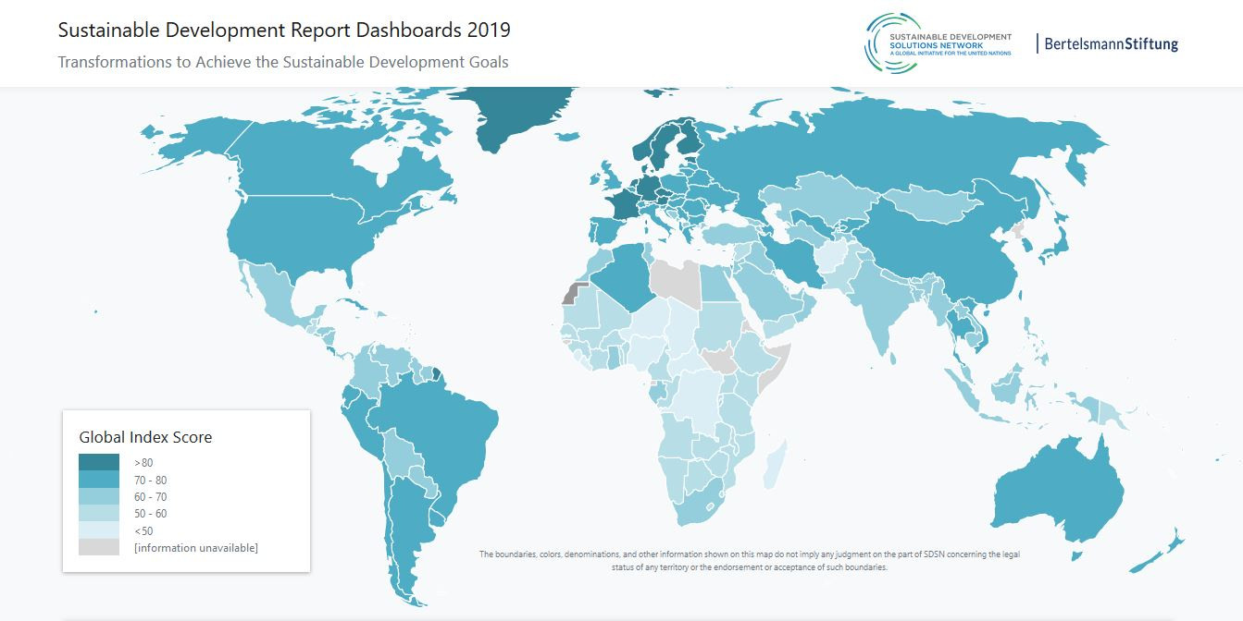
Figure 15 : SDGs Global Index Score
Source: Sustainable Development Report, 2019. *The darker the color of the region, the higher the score.

Slide 35
* Global Index Score and Demographic Development
Even though the SDGs Global Index Score integrates 17 different development goals, this geographic distribution suggests a strong relation to the level of development of the population (see Figure 15).
In this respect, it should be marked that the Global Index Score has a positive correlation with the life expectancy at birth (years) (ｒ＝0.905) and a negative correlation with the adolescent fertility rate (births per 1,000 women ages 15-19) (ｒ＝－0.756); ( see Figure 16 and Figure 17), respectively.
As it was mentioned above, these two indicators refer to the different phase of the historical process of the demographic transition in each country.

Slide 36
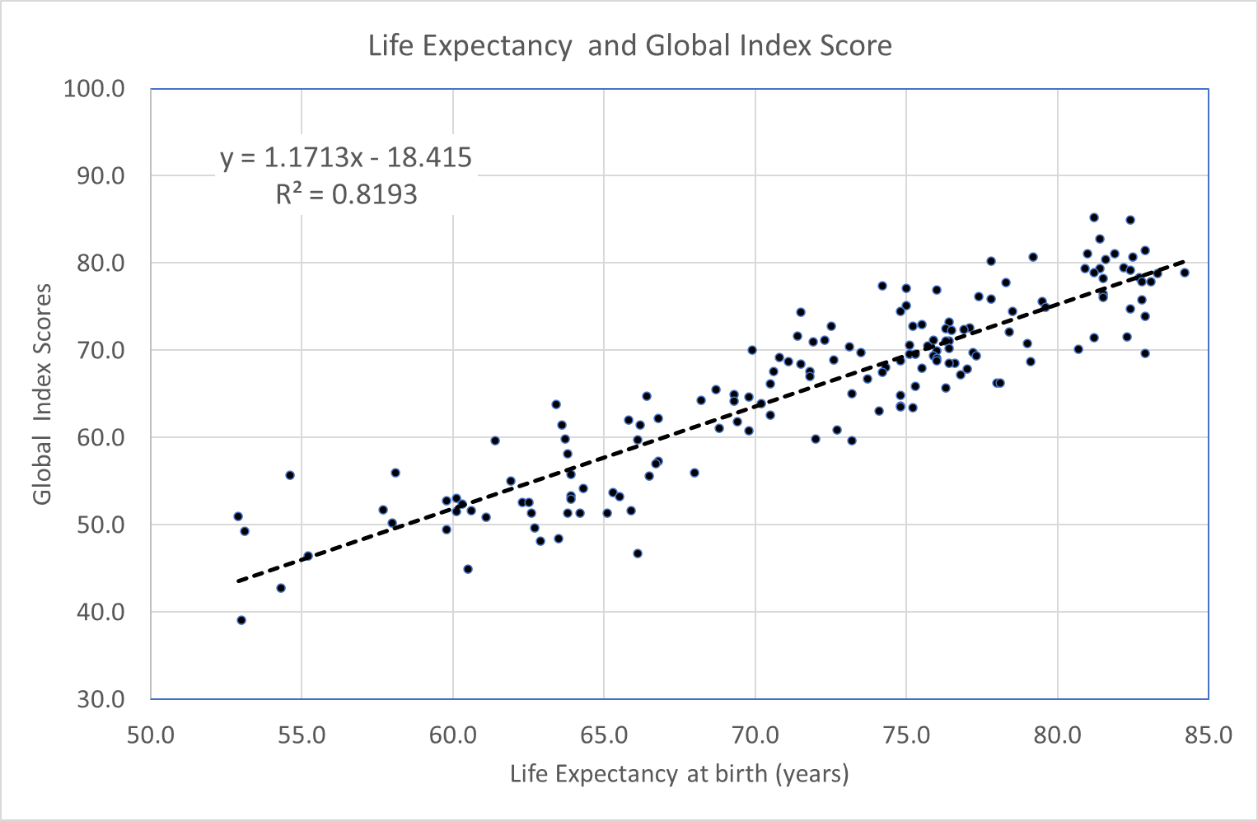
Figure 16: Life Expectancy and Global Index Score
Source: Sustainable Development Report, 2019

Slide 37
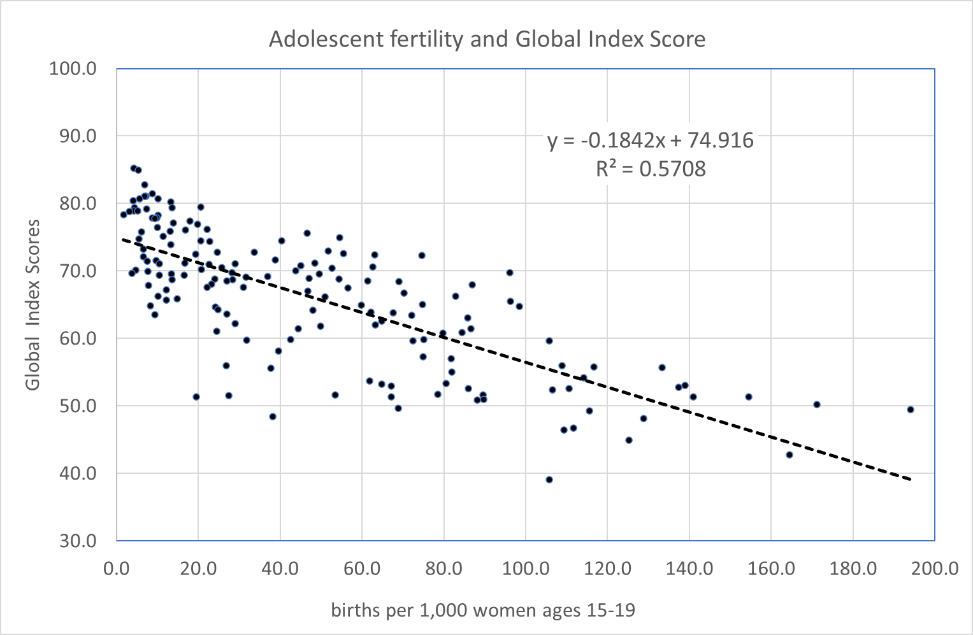
Figure 17: Adolescent Fertility and Global Index Score
Source: Sustainable Development Report, 2019

Slide 38
* *Global Index Score and Demographic Development
The Global Index Score tends to be higher for the early starter countries in demographic transformation, while it is less favorable for the later starter countries.
This may reflect the fact that the early starter countries are experiencing longer life expectancy, while fertility is below the replacement level and the birthrate is declining and aging. Indeed, such a demographic situation may have favored the SDGs' goals in the past.
However, such a simple relationship may no longer hold true when the the population begins to decline as rapidly as in Japan.
Notes:
I am afraid of More likely Another Scenario.
The main regions driving the world economy have already entered a post-demographic transitional stage characterized by below replacement fertility rate and a decreasing and rapid aging population.
They lost their economic power with their decreasing and rapid aging populations.
Then, the demographic transition of Sub-Saharan Africa will fall by the wayside, and the entire human society will be at high risk of collapse.

Slide 39
2-2 Population Increase vs. Decrease
Population Increase, r＞０ (figure 18)
Exponential growth (growth accelerates with respect to time)
Population explosion : r<+2%, Doubling time ≒one generation (by each 35 years).
Growth curve, approaching the limit of growth (also overshooting and shrinking).
Population Decrease, r＜０ (figure 18)
Exponential decline (decline accelerates with time)
Population Implosion r<-2%, Half-life ≒ one generation (by each 35 years).
A declining curve is drawn and the population shrinks toward the lower limit.

Slide 40
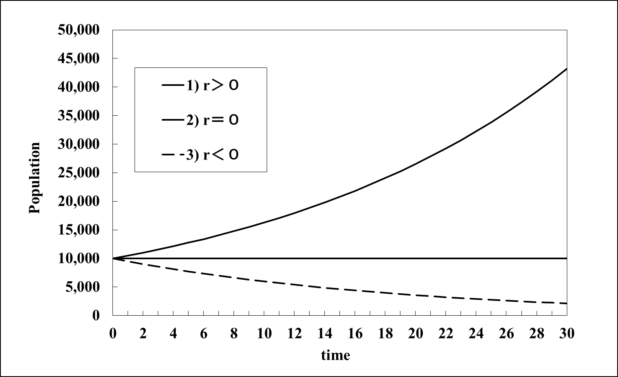
Figure 18: Exponential growth
(1) Population increases exponentially (i.e. in a geometrical ratio) if the growth rate
is positive (r > 0).
(2) Population is stationary if the growth rate is zero (r = 0).
(3) Population decreases exponentially (i.e. in a geometrical ratio) and reaches a
minimum (0) at the infinite position, if the growth rate is negative (r < 0).
(Hara 2020)

Slide 41
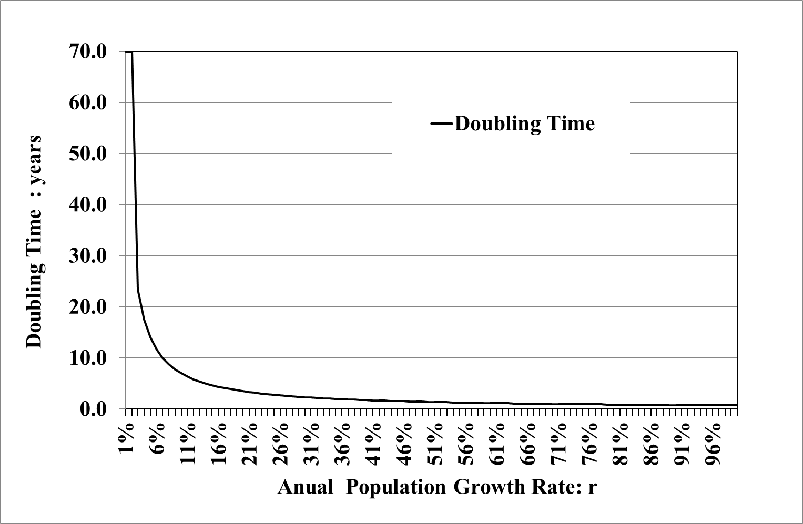
Figure 19: Doubling Time or Half Life
The doubling time is the same length for a decaying population. In this case, instead of “a doubling time”, the notion of “half-life (halving time)” is applied. The term “half-life” is rarely used in demography but very popular in archeology and atom physics to express a lifetime of the radioisotope. (Hara 2020)

Slide 42
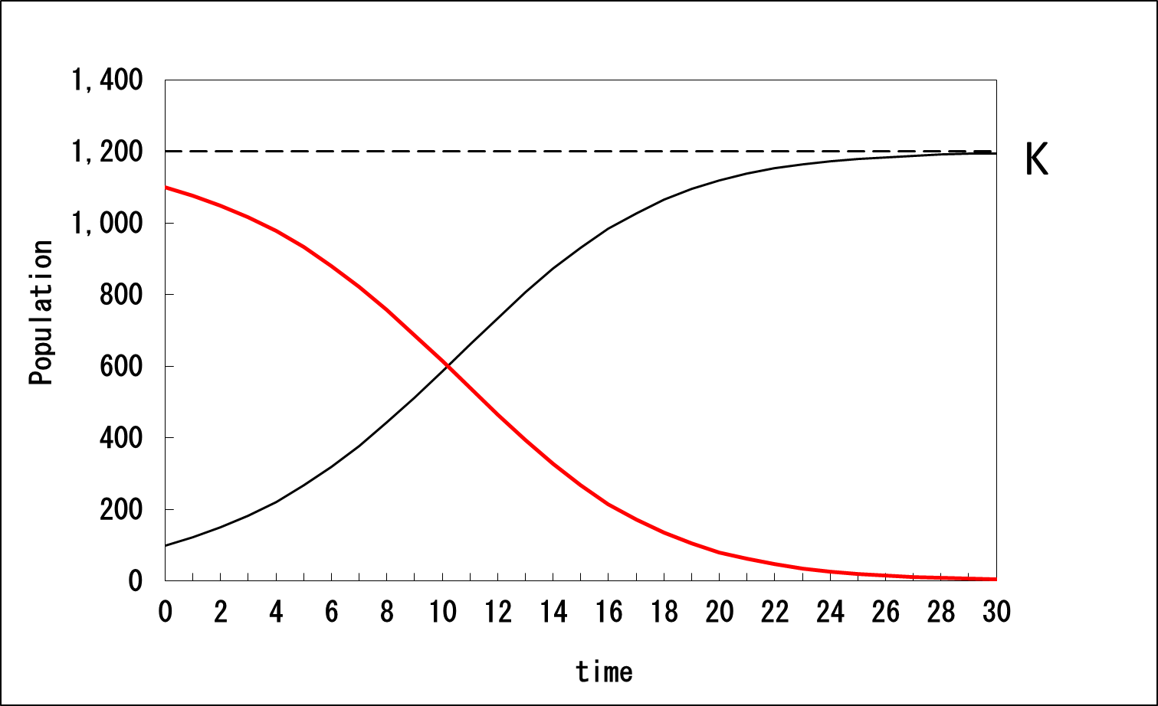

Figure 20 logistic curve and carrying capacity of the environment K
It is difficult to predict the level of K in the case of human beings.
It is because K is not fixed a priori but relatively changed according to the adaptation
capacity of the human being. (Hara 2020)

Slide 43
2-3 What is the problem with a shrinking population?
Social systems have developed as adapting to the size of the population, so as the population decreases, the social system must change accordingly.
Population growth also causes various problems, but population growth itself promotes the accumulation of social capital and the expansion of production. This makes it relatively easy to solve the problems (pie expansion, trickle down).
A shrinking population itself slows down the accumulation of social capital, but at the same time, the social system must be continuously restructured to accommodate the shrinking population. (Pie shrinking and sucking up).
Notes:
According to UN Projection 2017, the world's population in 2015 was 7.38 billion and it will increase continuously and will top 11 billion by 2100.
On the other hand, the same UN projection states that Japan’s population will decrease from 130 million in 2015 to 80 million by 2100. According to Japanese demographic institutes, Japan’s population will be even less than 60 million by 2100 (Fig. 1).

Slide 44
＊ What is the problem with a shrinking population?
Shrinking demand
Worsening cost performance
Needs for increasing productivity ⇒ mechanization
Changing labor demand and supply
Distribution issues,
Relationship with the environment and infrastructure
International population movement
Global decision-making issues, etc.
Notes:
According to UN Projection 2017, the world's population in 2015 was 7.38 billion and it will increase continuously and will top 11 billion by 2100.
On the other hand, the same UN projection states that Japan’s population will decrease from 130 million in 2015 to 80 million by 2100. According to Japanese demographic institutes, Japan’s population will be even less than 60 million by 2100 (Fig. 1).

Slide 45
2-4 Necessity to reorganize the relationship with the natural environment.
As the population size shrinks and the population density decreases, it becomes necessary to reorganize the relationship with the natural environment.
As populations thin out in depopulated areas, peri-urban areas, and even within large cities, the ecological balance is already being disrupted, causing wild animals to reproduce abnormally and invade human living areas from forest.
With a unilateral withdrawal from the ecological environment due to a decrease in population, the ecological environment will not necessarily recover its original balance, but rather the natural environment is likely to be devastated as people drop out of their living areas. In addition, such a devastated natural environment will be more vulnerable to climate change and extreme weather events.

Slide 46
2-5 Some Advices for Sustainable Use of Forest/Natural Resources
It is necessary to restore the sustainability of natural environments, including human population.
The population of forest areas is aging and decreasing faster than that of urban areas. The population density will rapidly decline and become diluted.
We need to design a new balance between the population and the forest ecosystem. It is not necessary to recreate the ecosystem of the past.
Notes:
According to UN Projection 2017, the world's population in 2015 was 7.38 billion and it will increase continuously and will top 11 billion by 2100.
On the other hand, the same UN projection states that Japan’s population will decrease from 130 million in 2015 to 80 million by 2100. According to Japanese demographic institutes, Japan’s population will be even less than 60 million by 2100 (Fig. 1).

Slide 47
2-5 Some Advices for Sustainable Use of Forest/Natural Resources
Minimize the environmental impact of the local population by promoting information and labor saving wherever possible.
The management of forests will be mostly by remote sensing, and local manpower will be smaller than ever.
Network the producer and consumer in distance to maintain market relationships.
Constantly develop new products in anticipation of climate change and ecological change due to global warming.
Diverse and multiple uses of the forest's ecological environment are desirable: production, housing, health care, welfare, education, research, and spiritual and cultural activities. No mono-culture !
Notes:
According to UN Projection 2017, the world's population in 2015 was 7.38 billion and it will increase continuously and will top 11 billion by 2100.
On the other hand, the same UN projection states that Japan’s population will decrease from 130 million in 2015 to 80 million by 2100. According to Japanese demographic institutes, Japan’s population will be even less than 60 million by 2100 (Fig. 1).

Slide 48
2-5 Some Advices for Sustainable Use of Forest/Natural Resources
Environmental management should be adapted to climate changes ⇒ Natural disasters such as forest fires have a long-term effect of enriching the ecosystem ⇒ It would be more rational to relocate people.
Eventually, we will have to design and create new artificial ecosystems, like the planetary remodeling project, but since rapid development has a high risk of causing the collapse of ecosystems, we need to take our time and develop through trial and error.
Thank you for your attention !

Slide 49
References
Hara T (2014) A Shrinking Society: Post-Demographic Transition , in Series: SpringerBriefs in Population Studies Subseries: Population Studies of Japan, (https://www.springer.com/gp/book/9789811336539).Springer
Hara,T(2020) An Essay on the Principle of Sustainable Population, in Series: SpringerBriefs in Population Studies Subseries: Population Studies of Japan, (https://www.springer.com/gp/book/9789811336539).Springer
IPSS (2023a) Population Projections for Japan: 2021 to 2070 (With long-range Population Projections: 2071 to 2120) https://www.ipss.go.jp/pp-zenkoku/e/zenkoku_e2023/pp_zenkoku2023e.asp
IPSS (2023b) Population statistics of Japan 2023. https://www.ipss.go.jp/p-info/e/psj2023/PSJ2023.asp
United Nations(2022a) World Population Prospects 2022 [Database]. https://population.un.org/wpp/
United Nations.(2022b) World Population Prospects 2022: Summary of Results. UN DESA/POP/2022/TR/NO.3.
Sustainable Development Report (formerly the SDG Index & Dashboards). 2019. GlobalIndexResults2019. https://www.sdgindex.org/reports/sustainable-development-report-2019/ Accessed 03 .09.202 .
Van de Kaa DJ (2002) The idea of a second demographic transition in industrialized countries. In:Paper to be presented at the sixth welfare policy seminar of the national institute of population and social security (NIPSSR), 29 January 2002. Tokyo, Japan. https://pdfs.semanticscholar.org/17c8/c2c3b43d447474107554926eb289d269c939.pdf.

Slide 50
Toshihiko HARA
Sapporo City University, Professor Emeritus (Ph.D. in Sociology)
Kita34 Higashi19 Chyome 3-7, Higashi-Ku, Sapporo, 007-0834 JAPAN
TEL/+81-090-2077-6027
E-mail：t.hara@scu.ac.jp，http://toshi-hara.jp

Slide 51
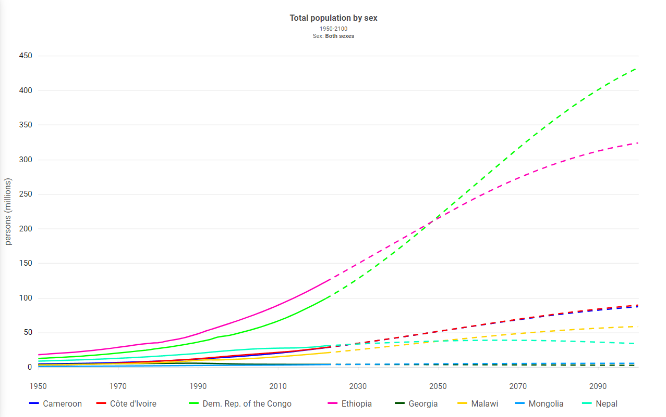
Total population
Medium variant
https://population.un.org/dataportal

Slide 52
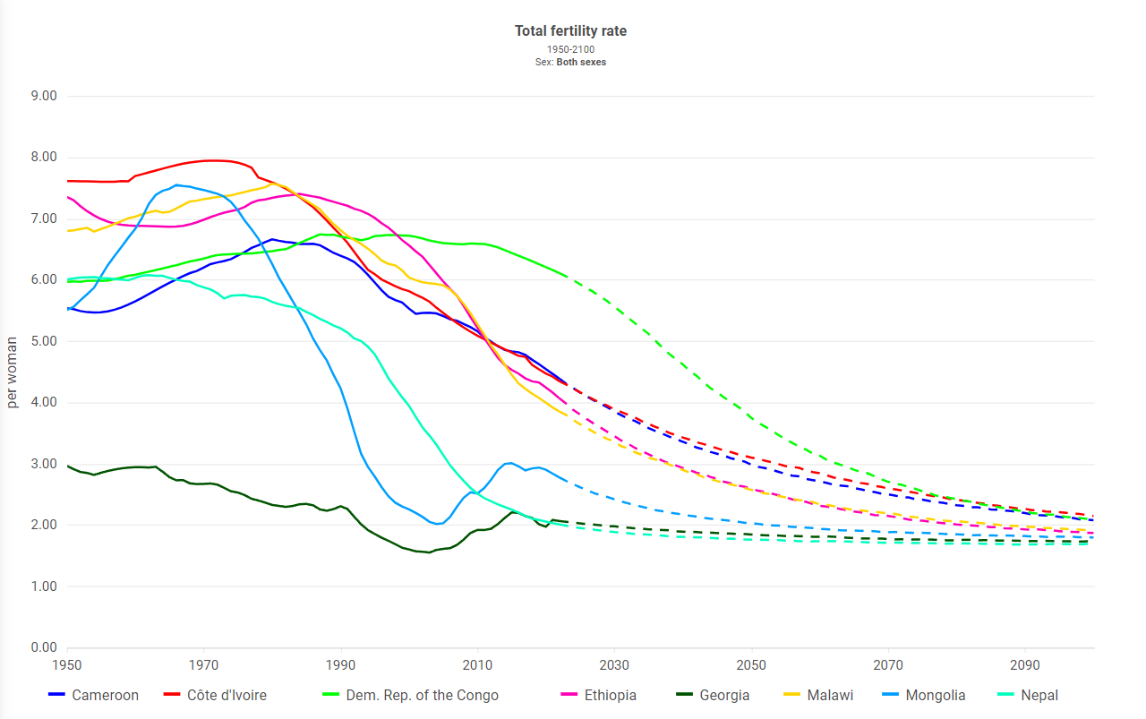
Total fertility rate
Medium variant
https://population.un.org/dataportal

Slide 53
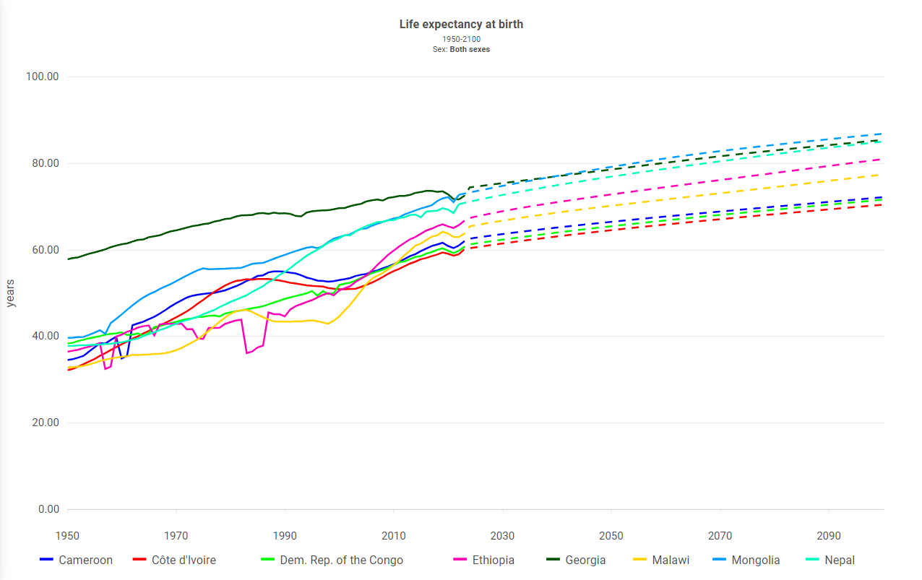
Life expectancy at birth
Medium variant
https://population.un.org/dataportal

Slide 54
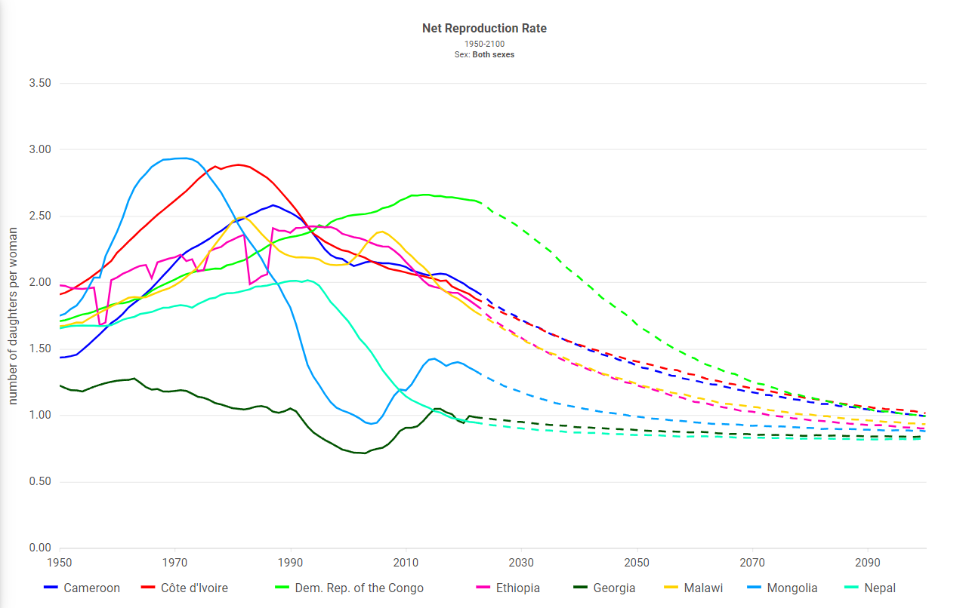
Net Reproduction Rate
Medium variant
https://population.un.org/dataportal
Notes:
https://population.un.org/dataportal/data/indicators/49,19,61,56/locations/384,496,524,454,268,231,180,120/start/1950/end/2100/line/linetimeplot

Slide 55
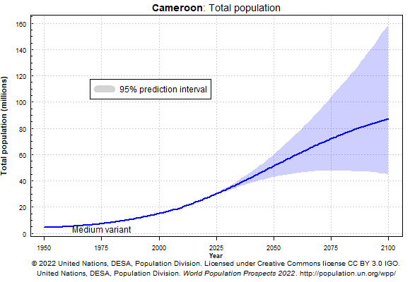
Cameroon
https://population.un.org/wpp/Graphs/DemographicProfiles/Line/120

Slide 56
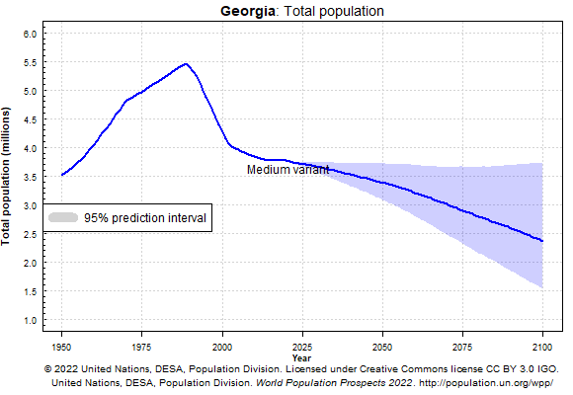
Georgia
https://population.un.org/wpp/Graphs/DemographicProfiles/Line/268

Slide 57
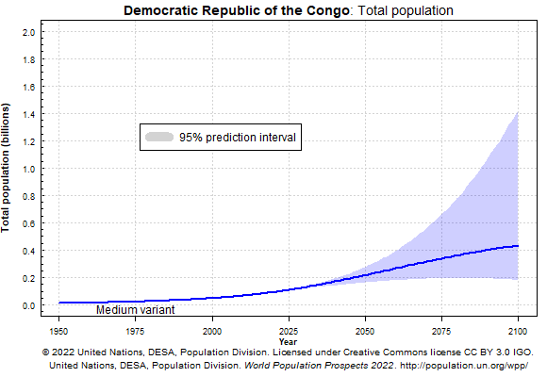
Democratic Republic of the Congo
https://population.un.org/wpp/Graphs/DemographicProfiles/Line/180

Slide 58
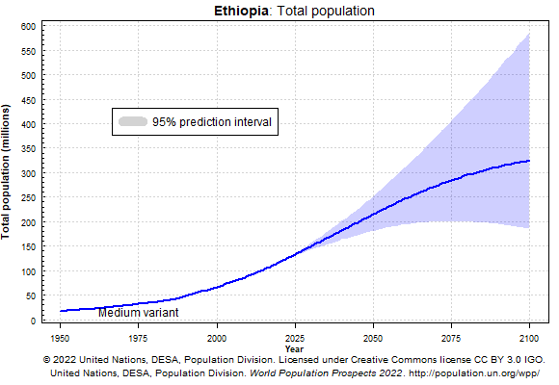
Ethiopia
https://population.un.org/wpp/Graphs/DemographicProfiles/Line/231

Slide 59
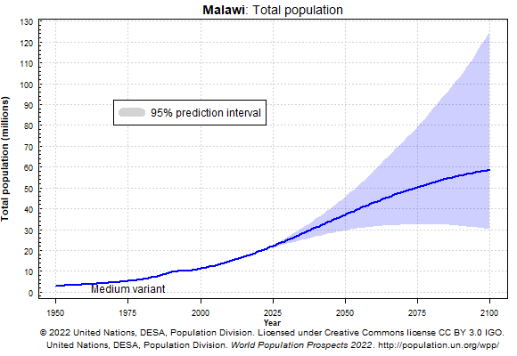
Malawi
https://population.un.org/wpp/Graphs/DemographicProfiles/Line/454

Slide 60
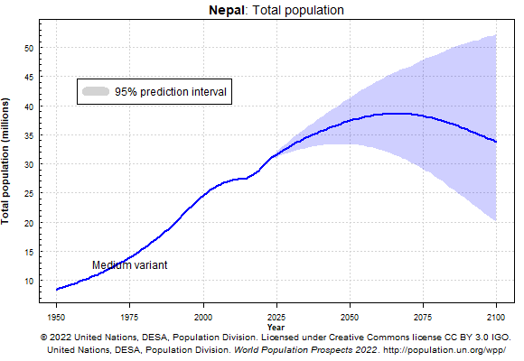
Nepal
https://population.un.org/wpp/Graphs/DemographicProfiles/Line/524

Slide 61
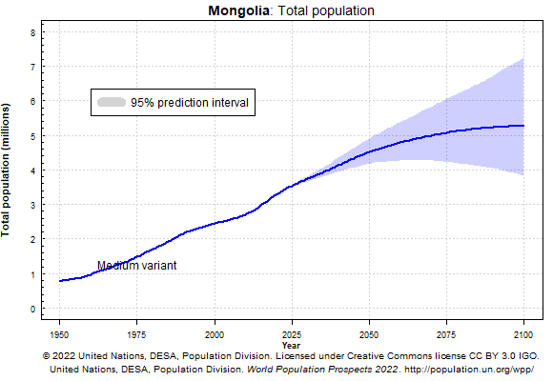
Mongolia
https://population.un.org/wpp/Graphs/DemographicProfiles/Line/496

Slide 62
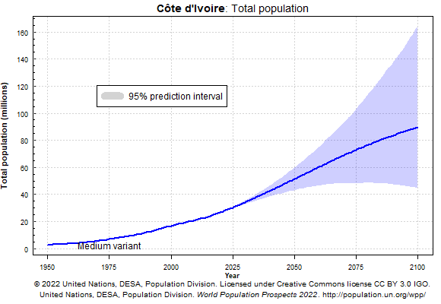
Cote d’lvoire
https://population.un.org/wpp/Graphs/DemographicProfiles/Line/384

